Slide 1
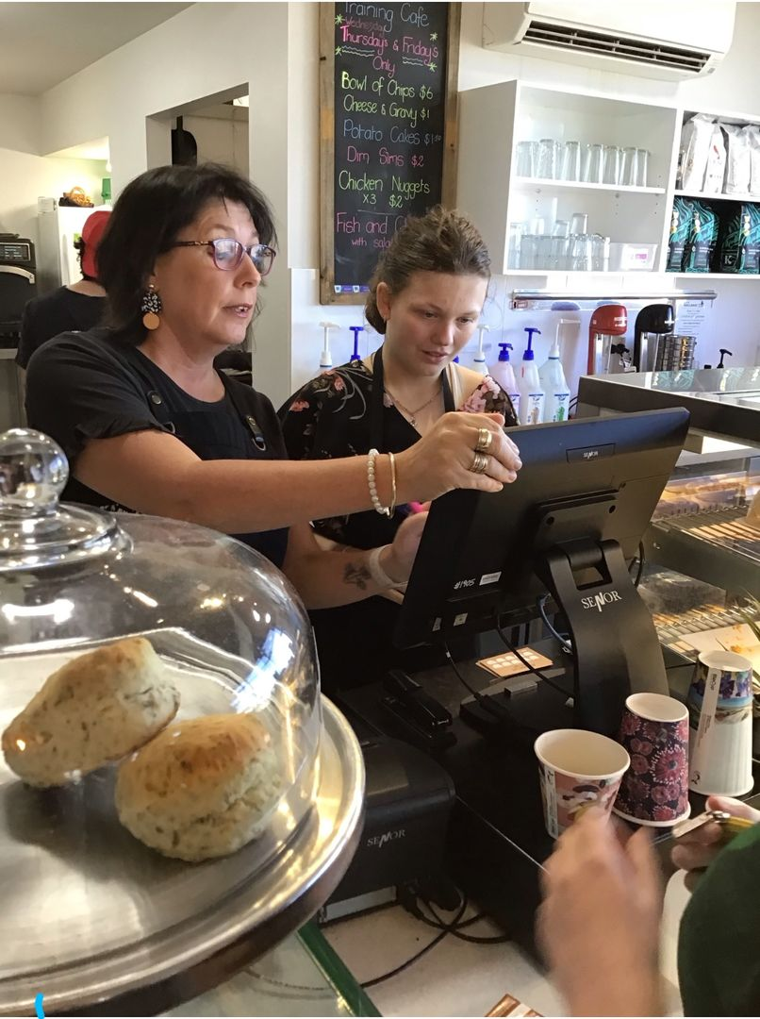
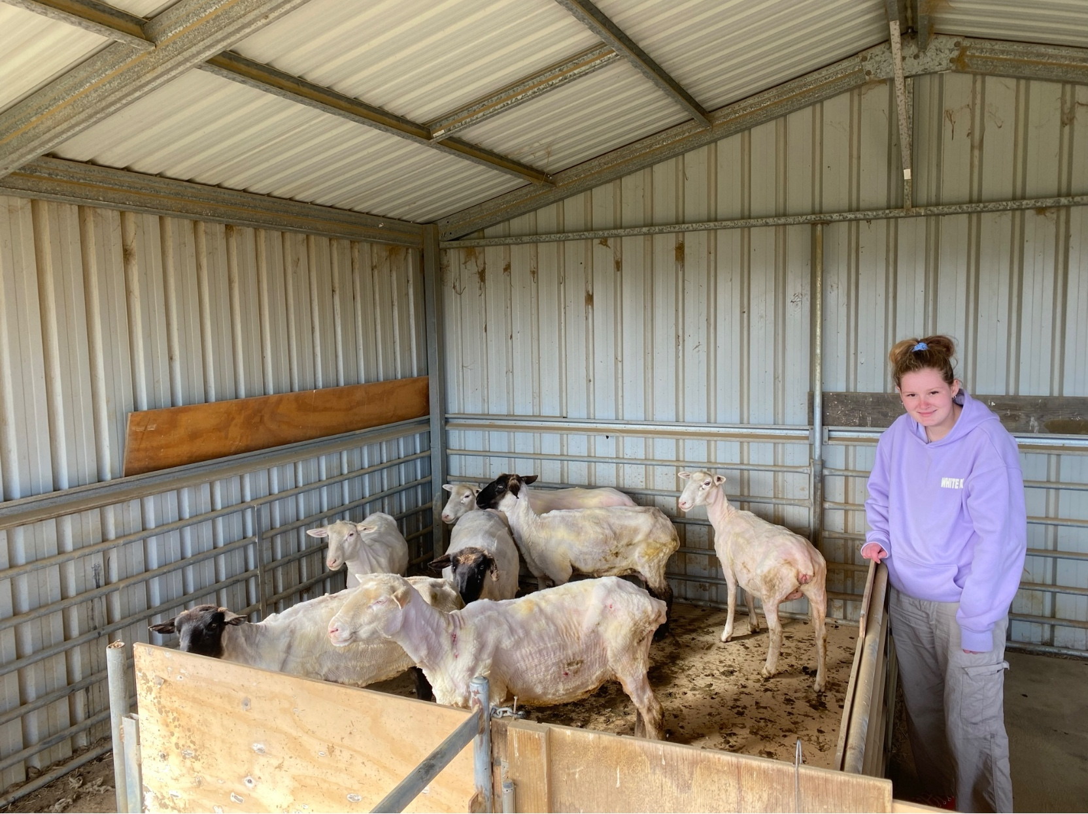
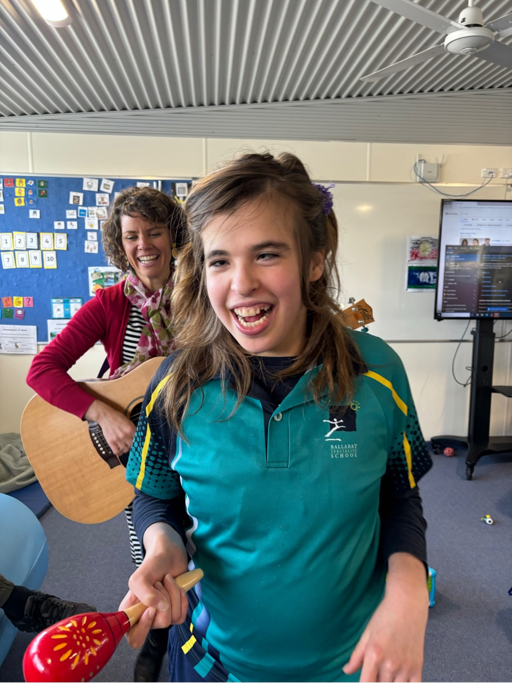
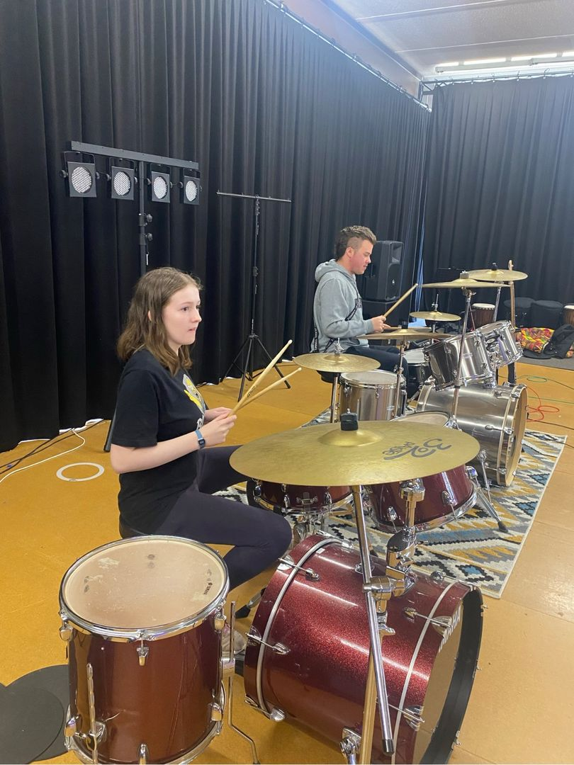
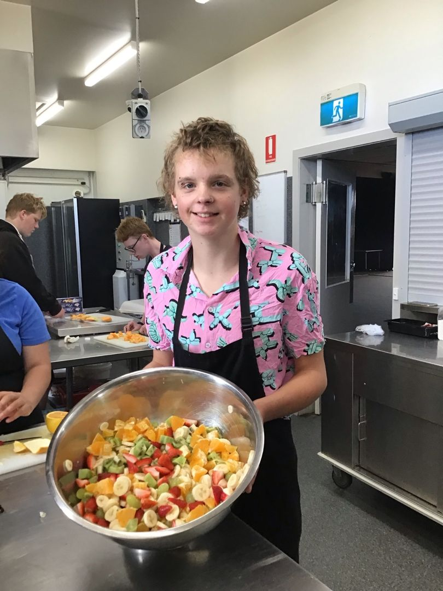
BSS-Senior FARM Campus

Slide 2
Acknowledgement of Country
We, at Ballarat Specialist School acknowledge the Traditional Owners of the land, the Wadawurrung people. We pay our respects to the Elders past, present and emerging.
We thank the Traditional Owners for custodianship of the land, and celebrate the continuing culture of the Wadawurrung people acknowledging the memory of honourable ancestors.

Slide 3
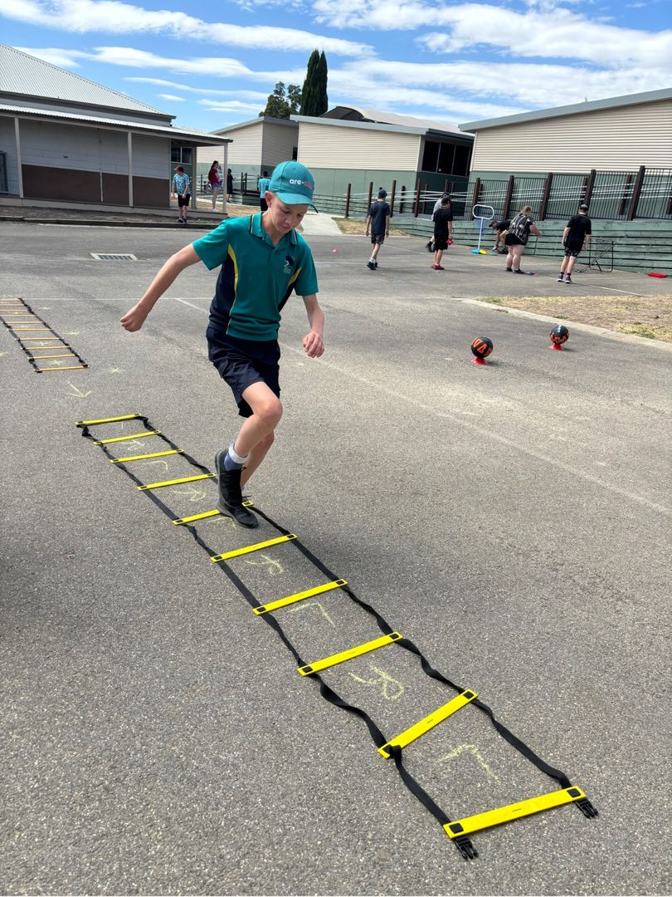
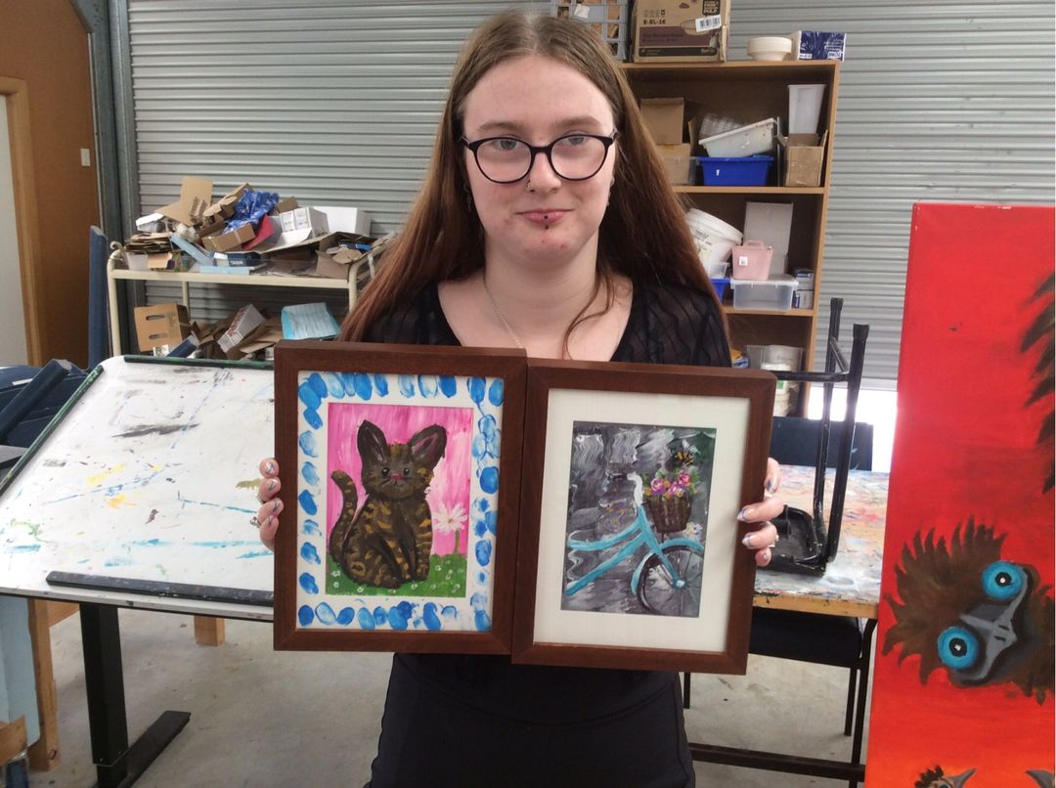
Who we are?
10 Classrooms
146 students enrolled
Curriculum - VPC across all classes
VET programs for all students (recognised TAFE courses delivered by BSS Staff)
Wellbeing team including therapy services full
time at the campus
Careers, VET & Work Experience Co-Ordinator as well as HeadStart Traineeships and Apprenticheship Co-Ordinator

Slide 4
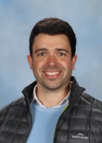
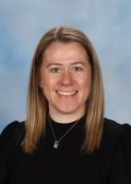
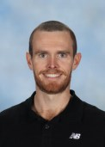
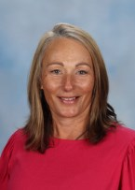
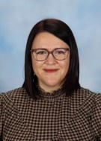
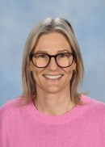
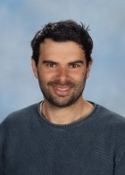
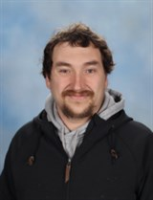
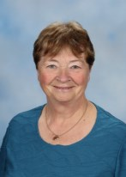
Key staff at the Senior Campus
Mat Gannon
Campus Principal
Tegan Winzar
Assistant Principal
Adrian Beer
Leading Teacher
Michelle Miller
ES Leader & Campus First Aid
Katie Howard
Careers/
Pathways & VASS Coordinator
Cheree Boulton
NDIS Navigator
James Reicha
SPLC1 Leader
Matt Piersma
SPLC1 Leader
Lynne Koene
SPLC2 Leader

Slide 5
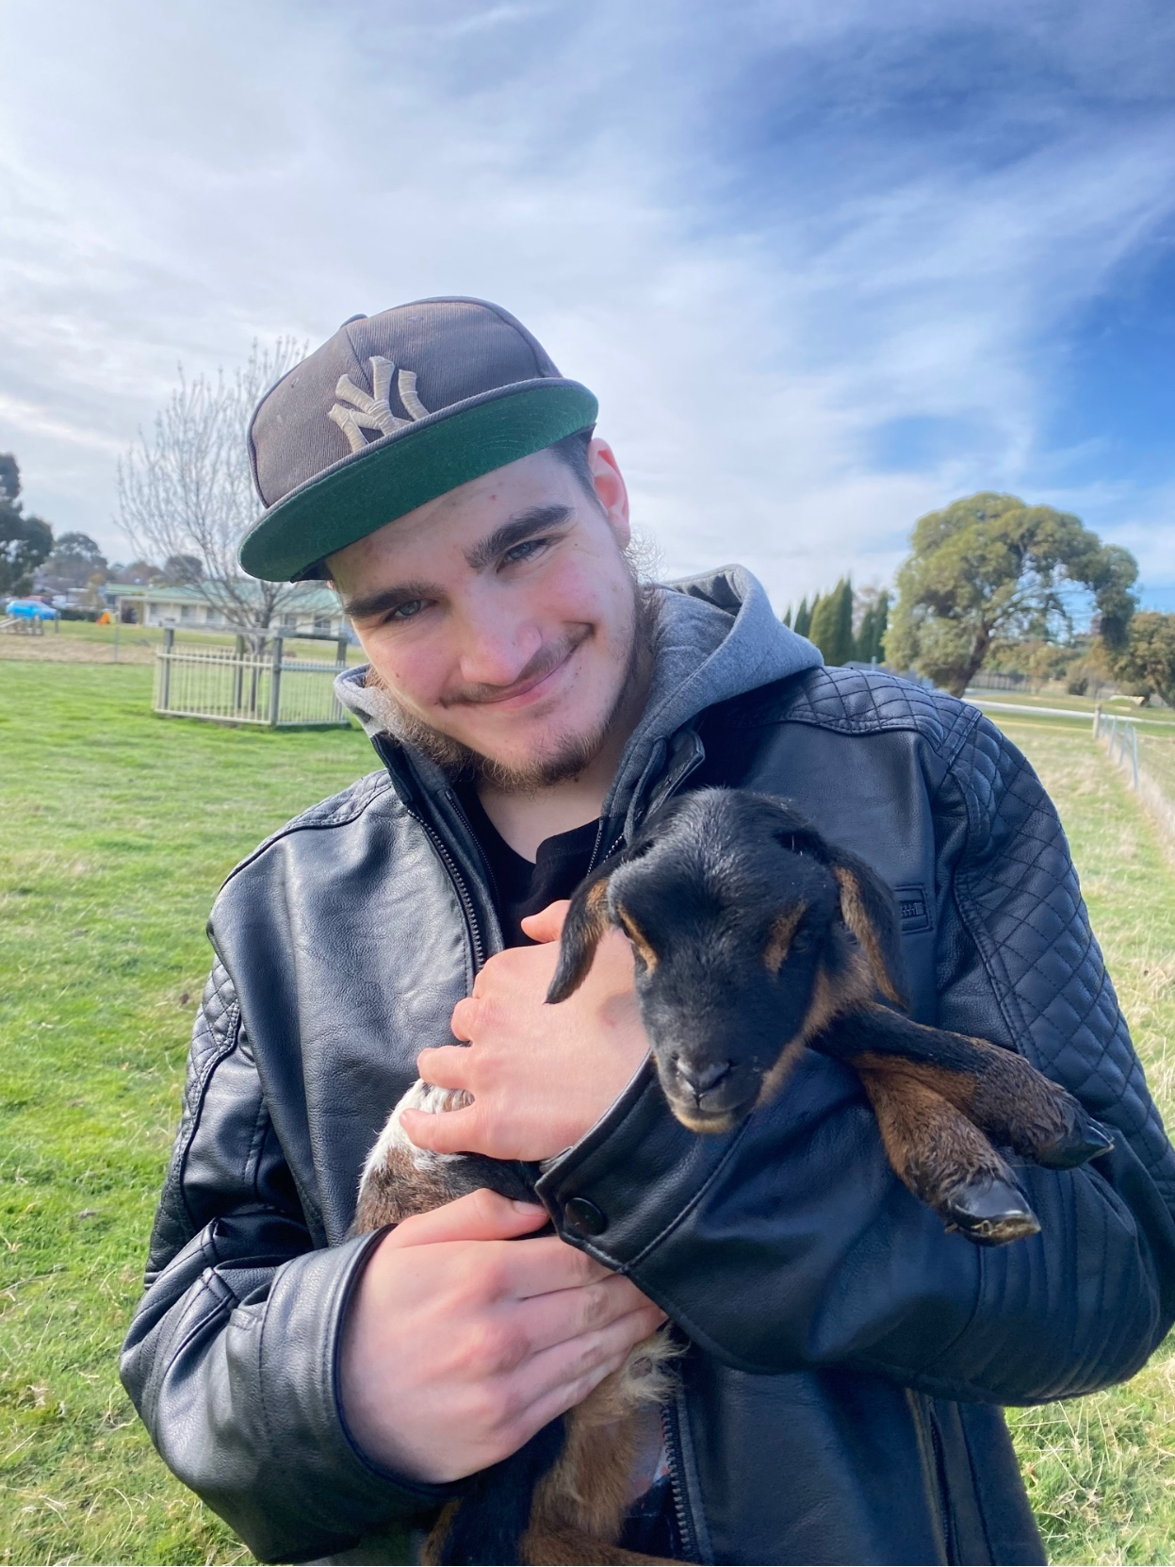
Additional Features of the FARM
Café and Op-Shop open to the public 5 days a week
FARM Track open to the community- approx. 1km
Close to 30 Farm Animals (excluding chickens)
Shared facilities with U3A
New projects coming…

Slide 6
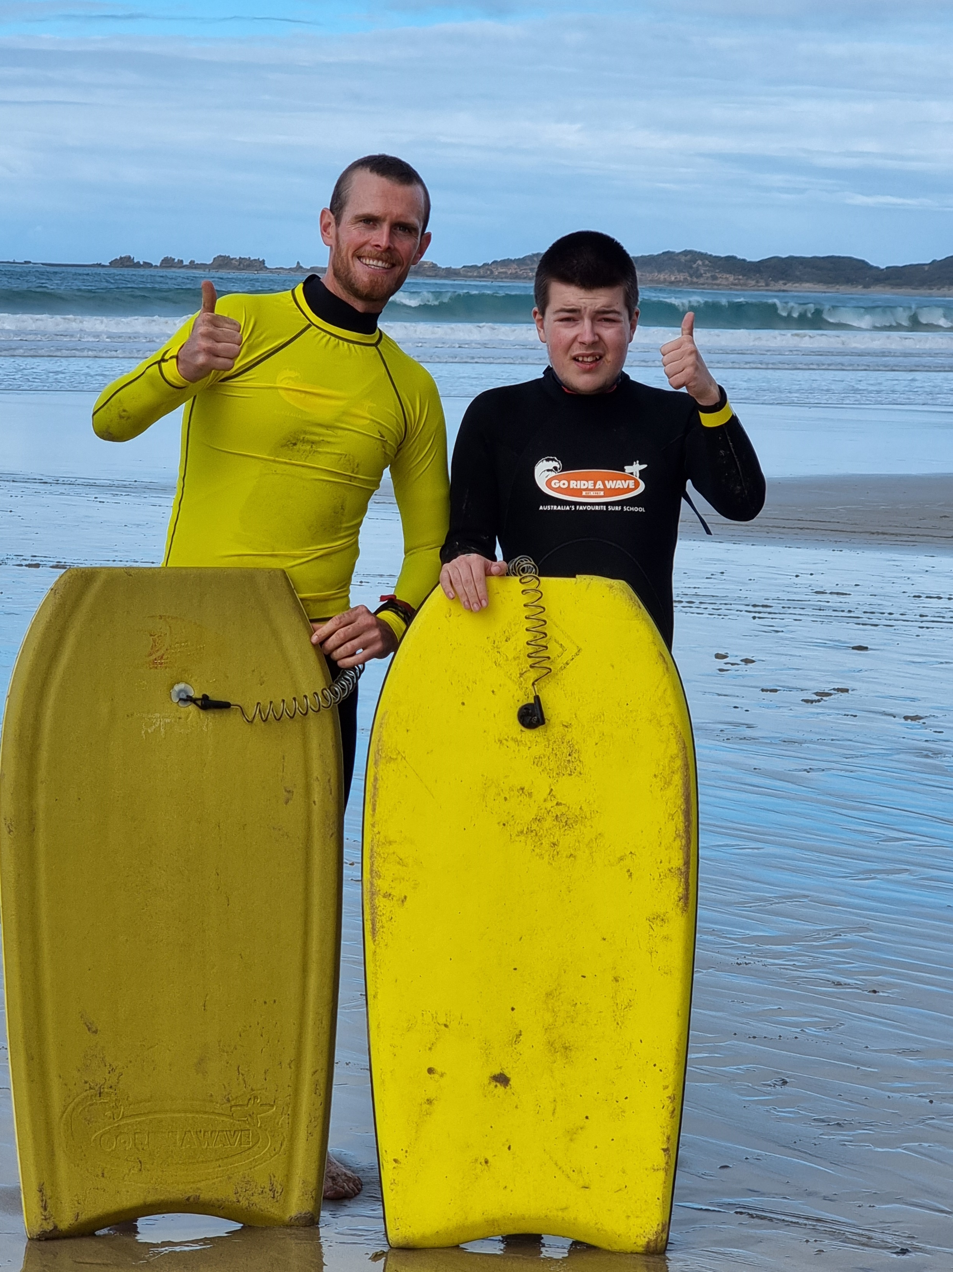
For Students
Year level camps
Excursions linked to curriculum
Excursions to promote positive engagement in the community
Musical showcases- All Abilities Eisteddfod
Post-school expo
Returning students afternoon tea
Formals
Graduation

Slide 7
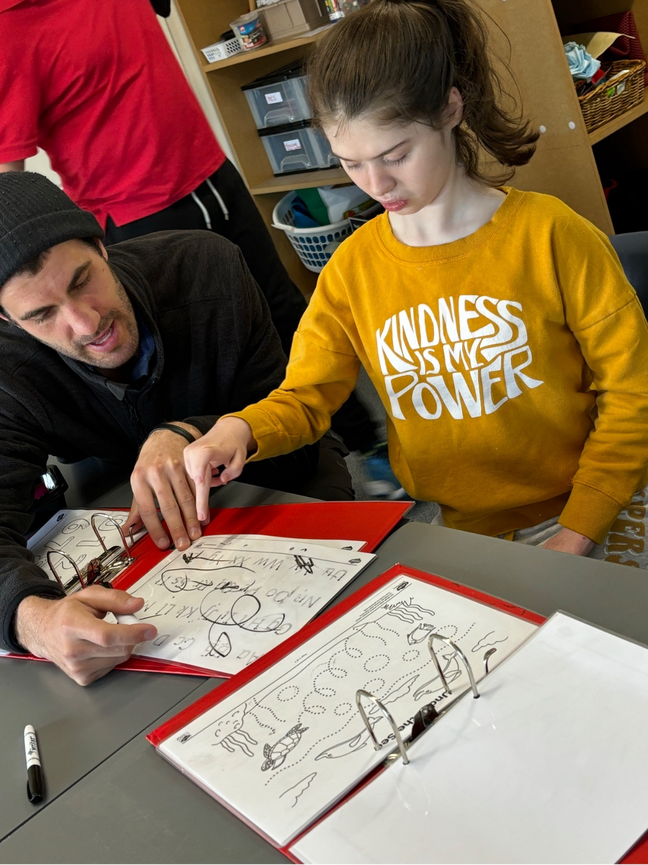
VPC (Victorian Pathways Certificate)
Senior secondary curriculum - written by the VCAA for students who would benefit from a more individualised program at a more accessible level
Age-appropriate experiences suited to Senior School (Years 10 to 12)
At BSS, students are exposed to the VPC for three years. Last year 4 Year 12 students completed their full VPC Certificate. This year, we have projected 11 Year 12s may complete it, along with 5 Year 11s.

Slide 8
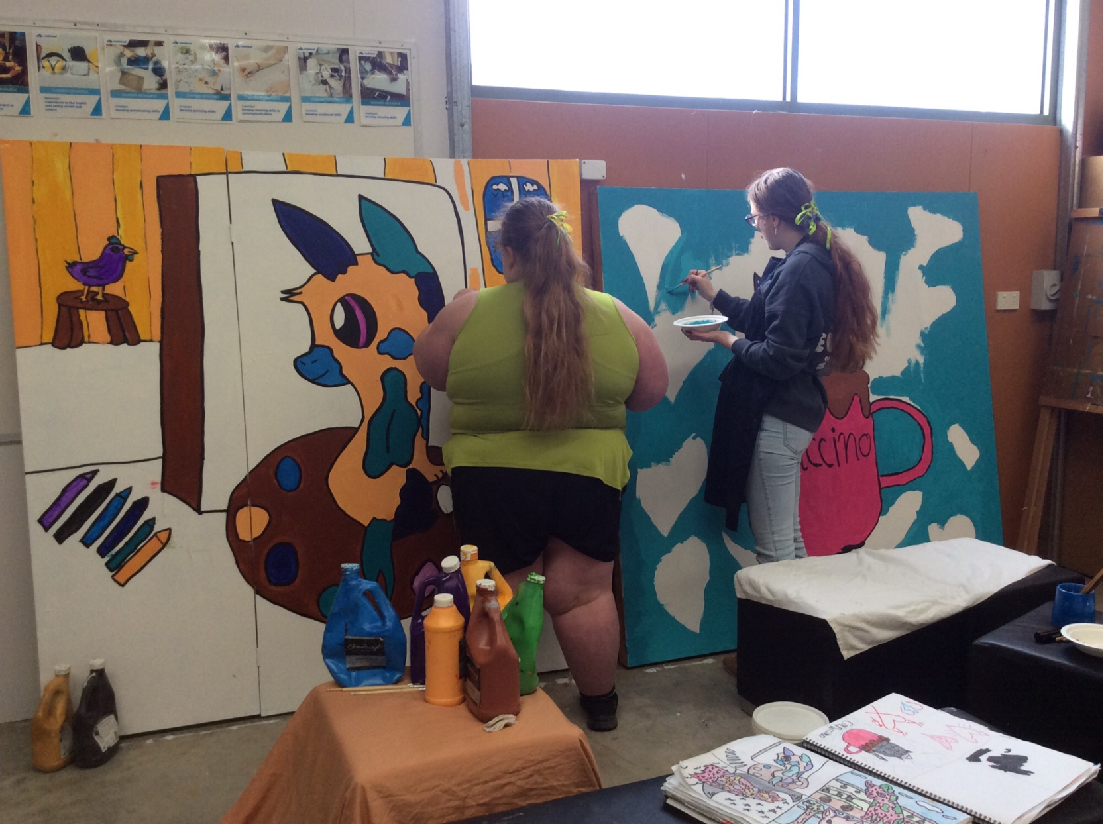
Current VET offerings
Current VET offerings 2024 encompassing Cert I, II, III and SBATs:
Cert I - Life skills (Pathways Academy)
Cert I - Hospitality (iVET)
Cert I & II – Retail/Workplace Skills (iVET)
Cert II – Cookery (iVET)
Cert I& II - Visual Arts (COSAMP)
Cert I& II - Sport & Recreation (iVET)
Cert II- Music (COSAMP)
Cert II Rural Operations- VEG Education
SBAT Cert II Horticulture-South West TAFE

Slide 9
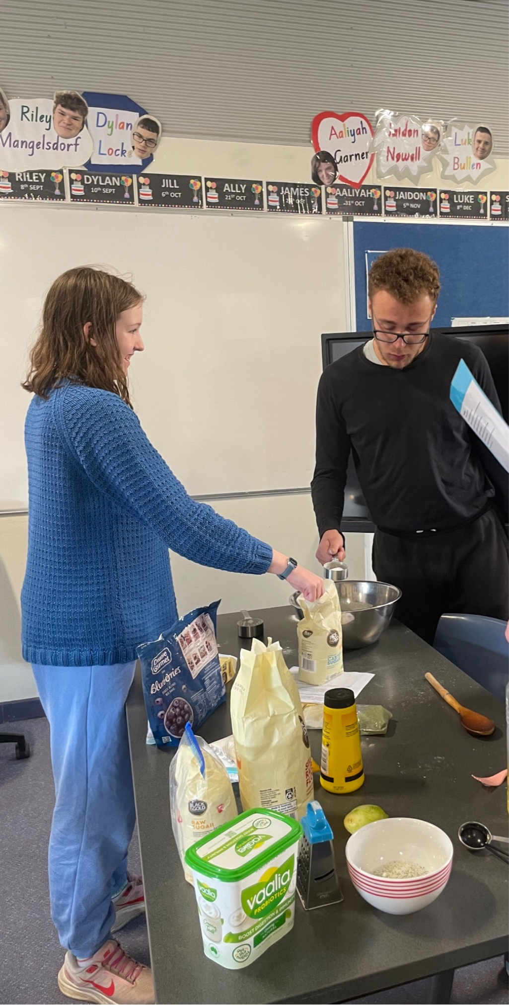
VET and VET Growth
Ballarat Specialist School has experienced significant growth from 2019.
Total number of Students 2019 – 2023 - 284
Number of students who completed certificates
2019 - 2022 - 55
2023 - 75
2024- 100 (projected)
VETDSS Growth
Certificate I,II,III
2019
13
2020
29
2021
83
2022
71
2023
84
Certificate 1 Growth
2019
0
2020
0
2021
0
2022
10
2023
30

Slide 10
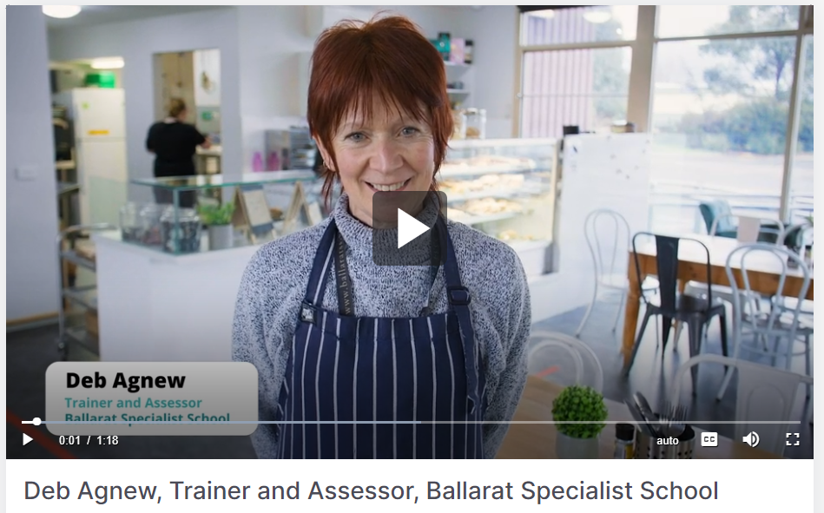
Hospitality/Kitchen Operations trainer- Deb
https://publish.viostream.com/play/bxixurbdwkgtfq

Slide 11
Student videos- “Why I like my VET course”
Phoebe- VET Cert 2 Workplace Skills
Michael- VET Cert 2 Music

Slide 12
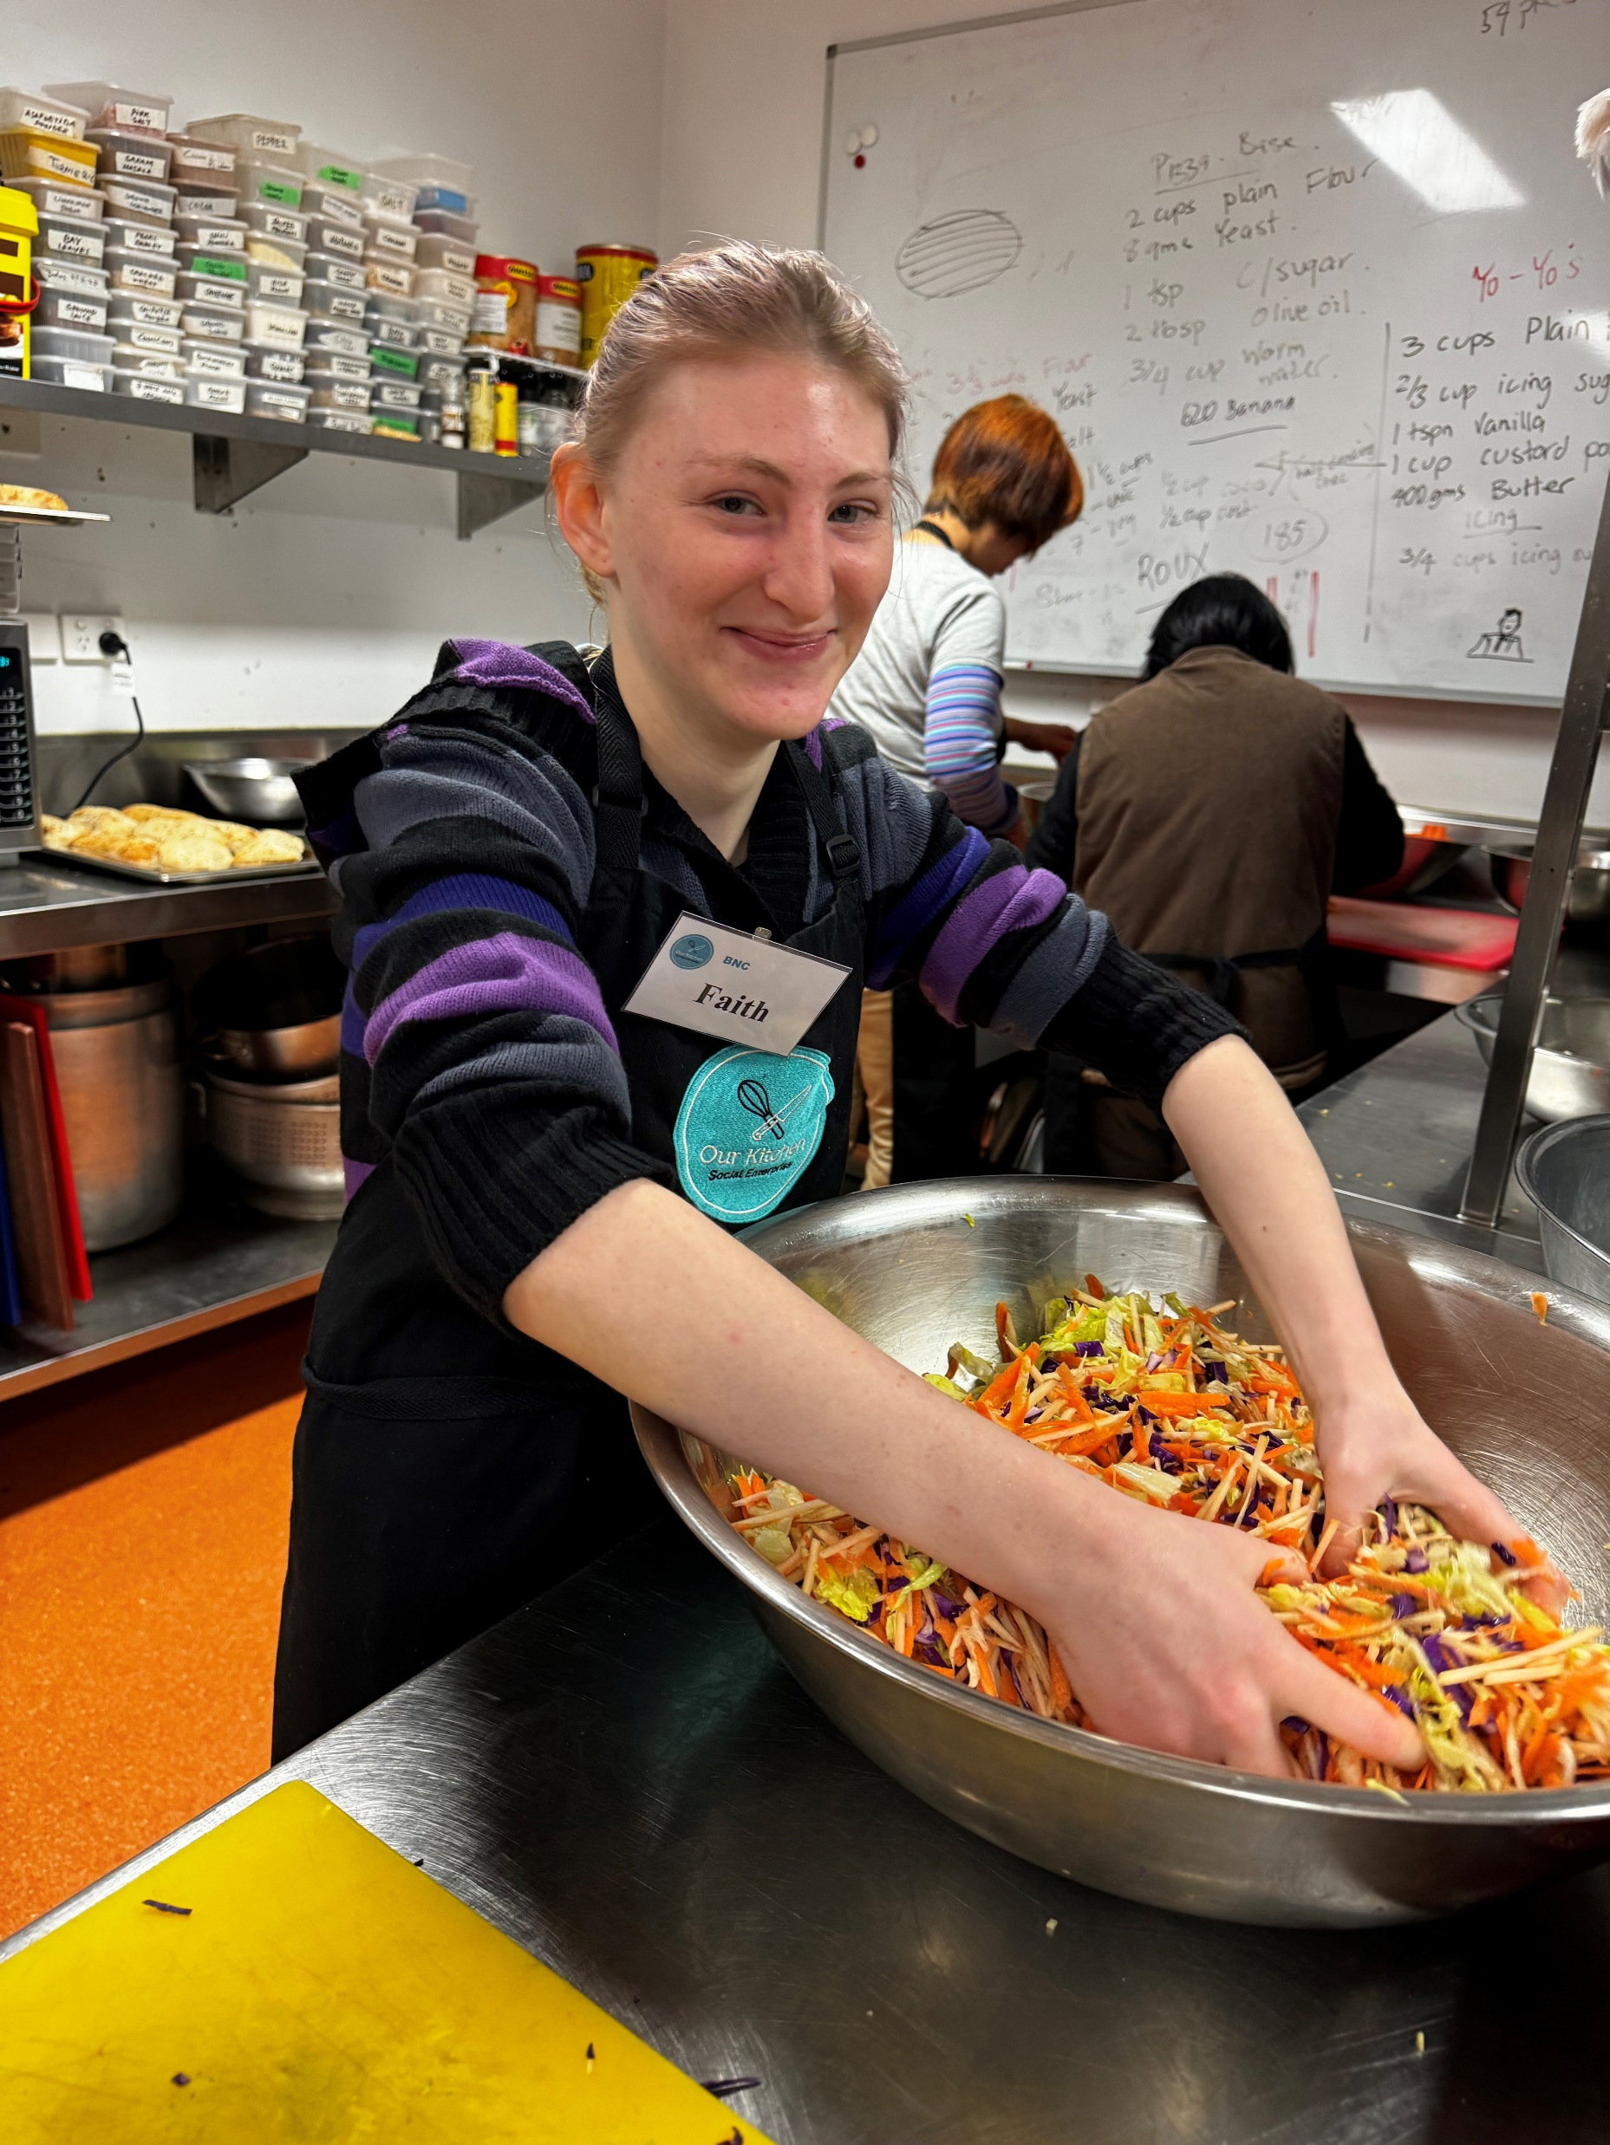
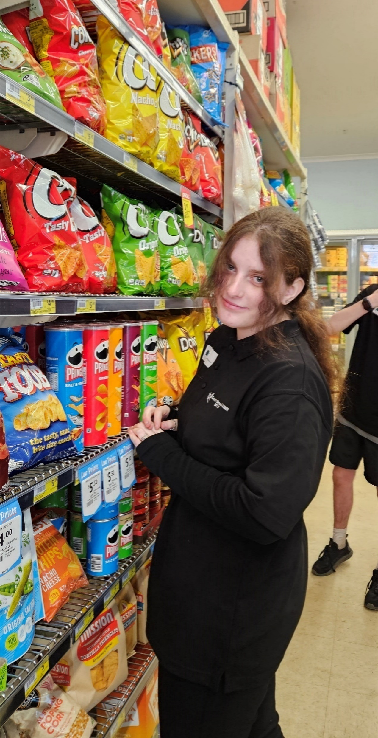
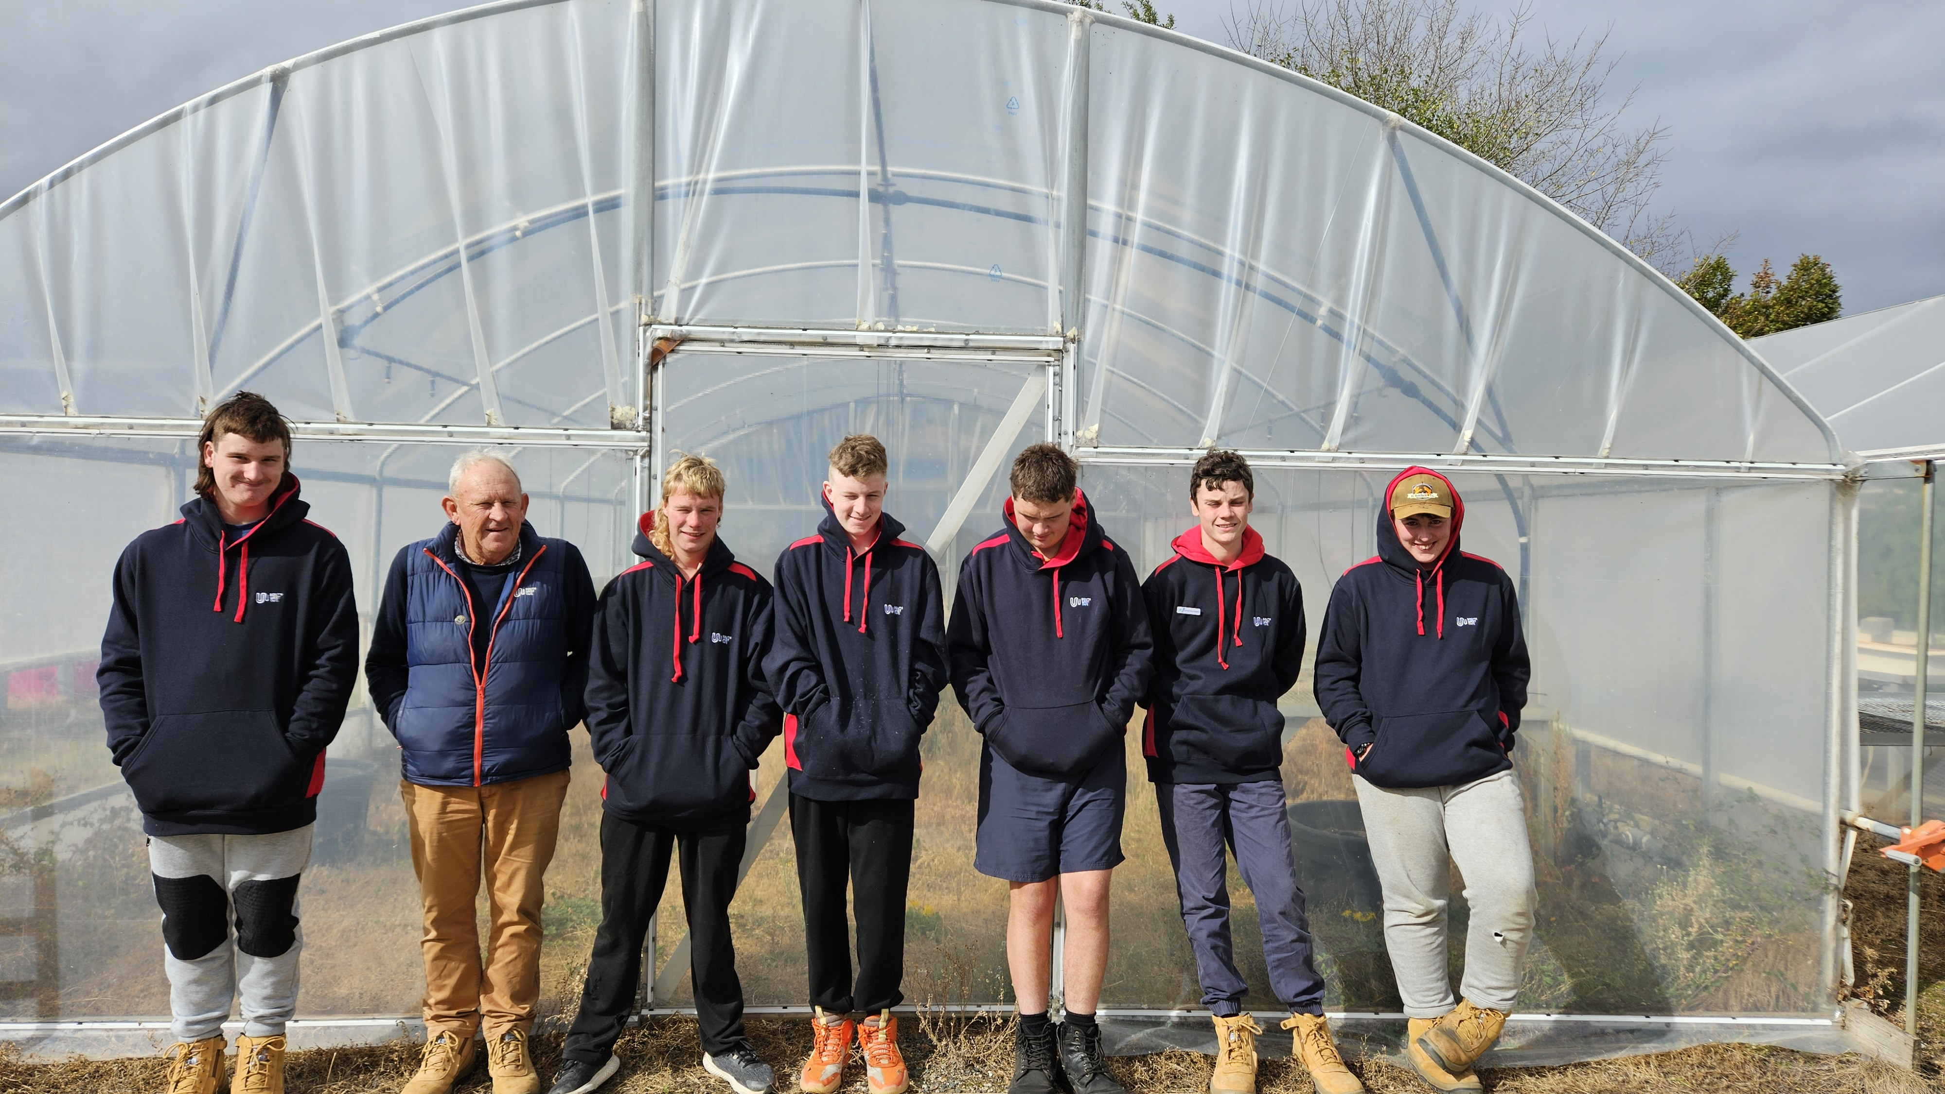
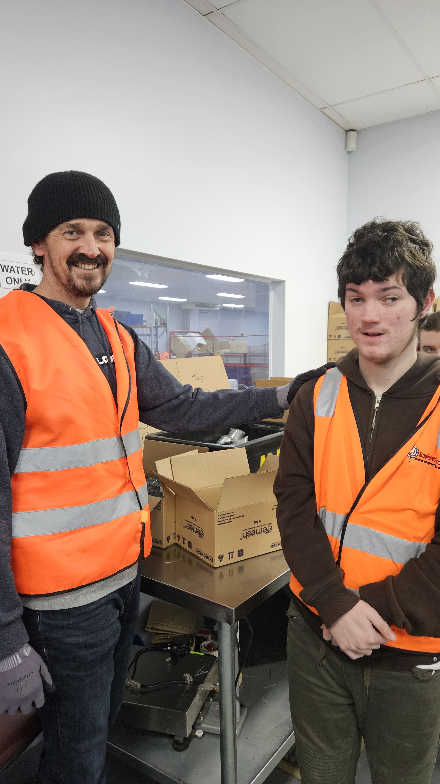
Careers, Pathways and Transition Coordinator
Work experience placements and Career and Pathway guidance support to Senior students.
Year 12 Pathway Planning meetings with families and students including referrals to NDIS support, linking in the NDIS Navigator
Development of Student Career Action Plans and other Career planning tools with students such as Morrisby assessment. Currently in the process of going through the Inclusive Careers Benchmarking tool.
Support School Based Apprenticeship programs through Westvic and HeadStart
School leavers tracking (done through the Past Student afternoon events twice a year).
Career related events/activities such as our annual Post School Options expo, industry visits and experiences, short courses delivered to students such as White Card and RSA.

Slide 13
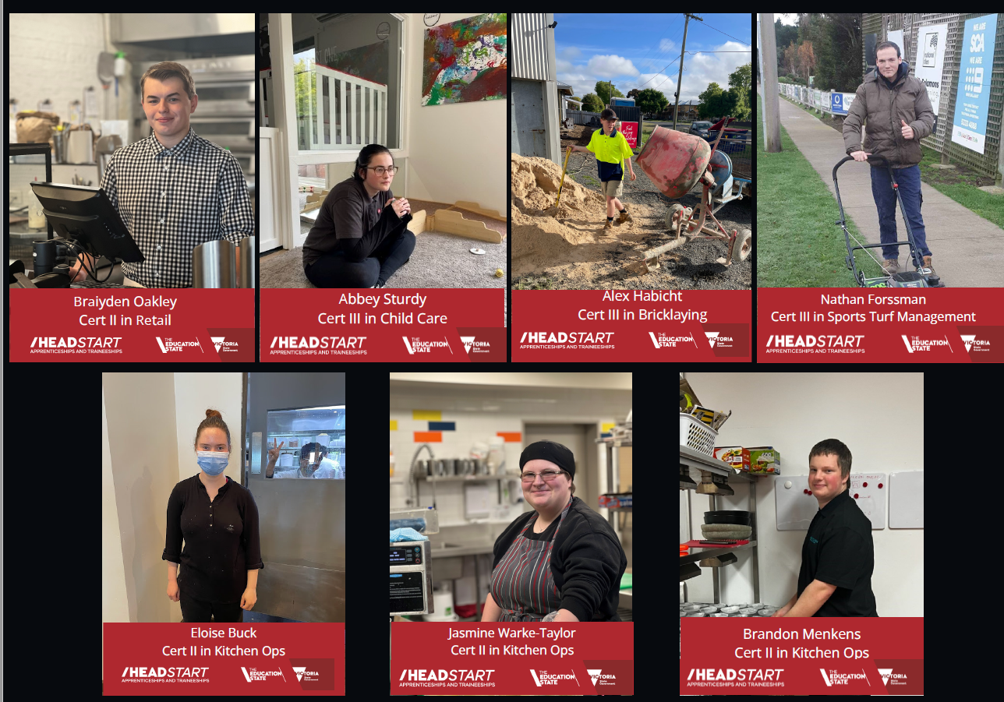
HEADSTART STUDENT SUCCESS STORIES

Slide 14
Questions/comments
?

