Slide 1
My Career Insights
‘Getting Prepared’ for
MORRISBY PROFILING
<school name>
<date>
Notes:
(Slide 1) My Career Insights - ‘Getting Prepared’ for Morrisby Profiling
Presenter welcome and introduction of self.
Morrisby is a popular Morrisby careers program - running in over 450 schools across Victoria for Year 9 students.
Exciting springboard to lots of new opportunities that will quickly become available to you - Work experience, part time work, pathway choices.
You will be asked to consider your thoughts about further study, jobs, careers and subject choices
You will be undertaking an online career discovery profile – “Morrisby” – helps outline your strengths (brain power!), interests and aspirations

Slide 2
What is Morrisby?
Series of short questionnaires and quizzes
Profiles your verbal, numerical, abstract, spatial and mechanical aptitudes
Incorporates your talents, motivations, personality and work preferences.
Watch this explanation of the Morrisby Profile.
If the video isn’t playing or allowing fullscreen view, copy and paste this link into YouTube to watch it there instead
https://www.youtube.com/watch?v=8kZp4w69S2w
Notes:
(Slide 2) What is Morrisby?
The Morrisby profile is an online tool to inspire and give you some guidance on your strengths and interests and how to find career and study options that suit you.
You will be guided through a series of short quizzes and questionnaires
Profiles your verbal, numerical, abstract, spatial and mechanical aptitudes
Incorporates your talents, motivations, personality and work preferences.
Before I show you what some Morrisby questions look like, let's have a look at a short video that will explain things further.
* Click star top left of slide 2 in preview column, or click on play button on screen.
* If the video isn’t playing, copy and paste this link into YouTube - https://www.youtube.com/watch?v=8kZp4w69S2w

Slide 3
Why complete
the Morrisby Profile?
Notes:
(Slide 3) Why do a Morrisby Profile? – 10 Highlights
Deciding what you want to do after you leave school is not easy. Understanding the options available to you in the first place is hard enough, but then working out what you are best suited to and how you can achieve your goals is difficult.
Gain insight into your talents, personality, interests and work habits.
Speak to the 10 highlights o a Full Morrisby Profile
Find out about YOUR; Skills & Talents, Interests, Work Style, Preferred Workplaces, Personality & Learning Style
Discover & Explore; Career Suggestions
Plan Study & Pathway options
On completion of your profile, you will have the opportunity to discuss your results with a Morrisby-trained Careers Consultant.
A great resource alongside your current career education opportunities within your school
This information can provide something tangible, to help you when thinking about future pathway choices

Slide 4
What do the quizzes look like?
- Aptitude examples
Open a new browser and go to -> app.morrisby.com/practice-questions
These practice aptitude questions are designed to familiarise you with the style of questions you will be answering in your profiling session.
If clicking on the image isn’t working, copy and paste this link into the URL bar instead
https://app.morrisby.com/practice-questions
Notes:
* School to choose this interactive slide (requires 5 mins) or next (2 mins) ..
(Slide 4) What do the quizzes look like? – Aptitude practice example questions (notes to be updated)
We can have look at what Full Morrisby profiling looks like, by going to the Morrisby website at app.morrisby.com/practice-questions
Let's have a go at some practice questions so you will know what to expect when you do this yourself
While this short practice doesn't cover every question type, it will give you a good idea of how the profiling works.
* Ctrl/Click on the image or arrow at bottom right of image
* If clicking isn’t working, copy and paste this link into the URL bar instead https://app.morrisby.com/practice-questions

Slide 5
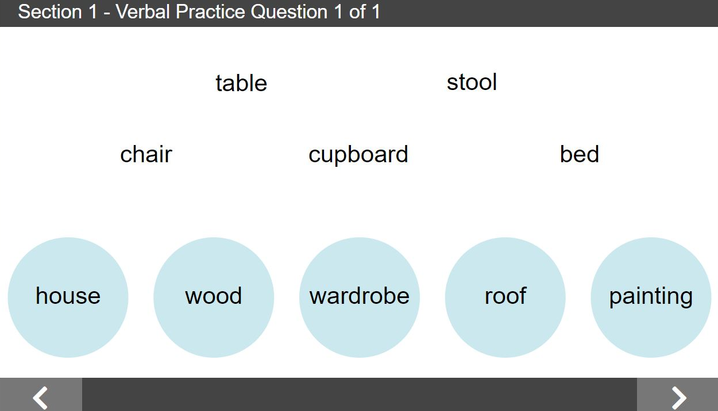
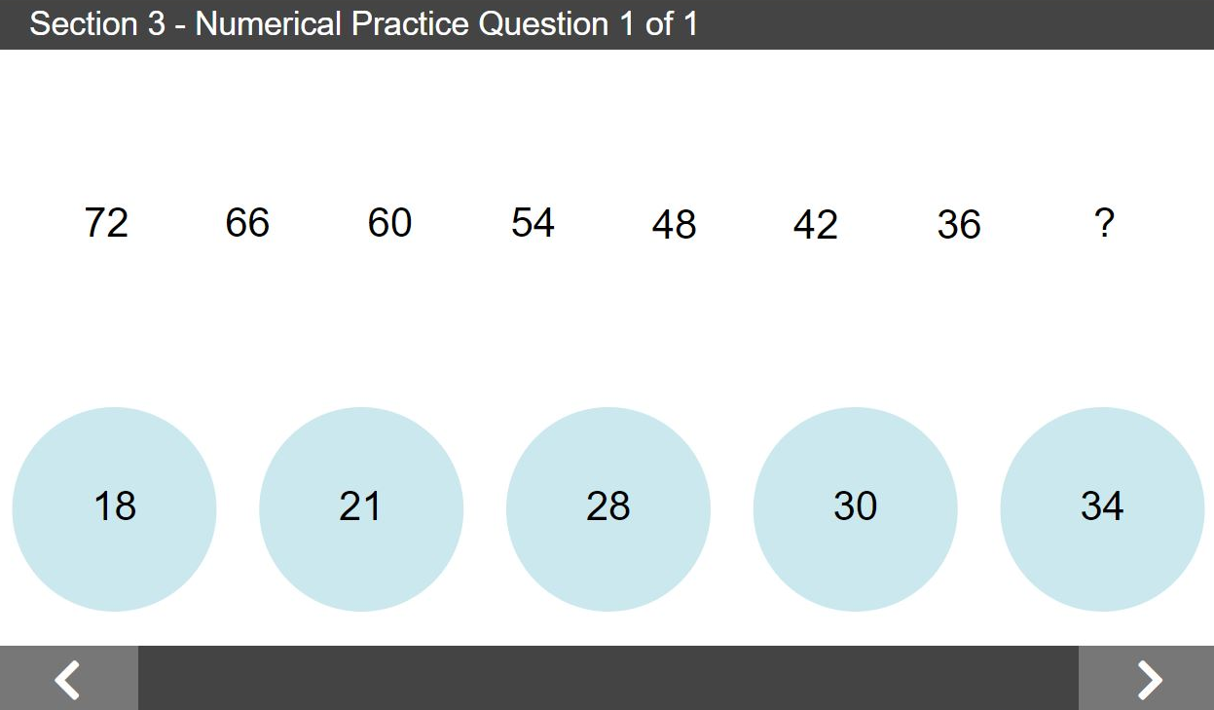
What do the quizzes look like?
- Aptitudes examples
Notes:
* School to choose this static slide (requires 2 mins) or previous (5 mins) ..
(Alternative Slide 4) What do the quizzes look like? – Aptitude practice example
Here are some examples of profiling questions from 3 of the aptitude assessments.
Verbal – 5 words at the top have something in common. Which word in blue circles also has something in common? – Wardrobe (furniture)
Numerical – Look at sequence of numbers, try to find a pattern. What number from below would fit the pattern? – 30 (reducing by 6 each time)
Abstract – 5 shapes at top follow similar rules. Which shape in blue circles follows same rule? – last one (2 identical shapes cross over inside + different outside shape)

Slide 6
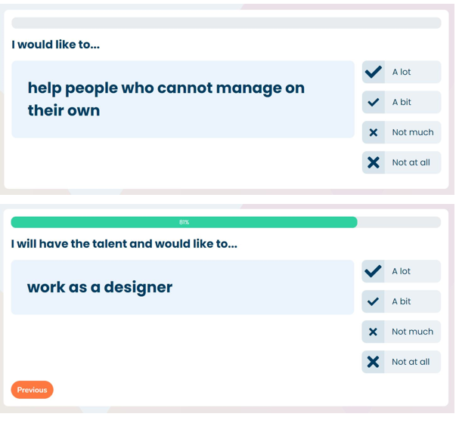
What do the questionnaires look like?
- Interest and Personality examples
Notes:
(Slide 6) What do the questionnaires look like? - Interest & Personality sample questions
Here are some examples from the Interests and Personality questionnaires.
After reading the question carefully, you will select your best answer
Interests - from 4 multi-choice possibilities
Personality - from 5 options

Slide 7
How long will
full profiling take?
The full profiling session will take approximately 2 hours.
There are 8 timed aptitude modules and 2 untimed multiple-choice questionnaires (Interest and Personality).
A count-down timer is shown on the screen.
Read the instructions for each module carefully.
If a question seems too hard, don’t spend too long on it. Make your ‘best guess’ and go on to the next question.
Notes:
(Slide 7) How long will full profiling take?
The full profiling session will take about 1 hour and 50 minutes
There are 8 timed aptitude modules and 2 multiple choice questionnaires (Interest and Personality)
Read instructions carefully. Practice questions - optional
Count-down timer. Don’t expect to complete all questions in designated timeframe
If a question seems too hard, make your ‘best guess’ and go on to the next question
If finish module early, wait until timer stops – revisit questions
If need to leave the room, finish module, SAVE, logout
When you return, login and recommence where left off

Slide 8
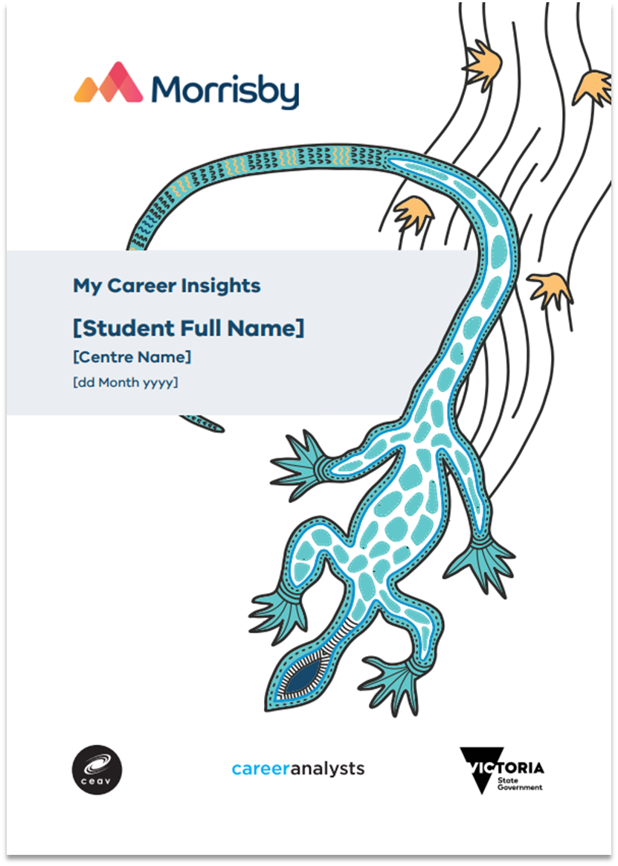
Important!
It is important that we have true and accurate results so that you have an authentic Morrisby Profile
It is important that all answers are your own to make sure the results reflect your strengths and preferences
This is not an exam, there is no pass or fail!
**Your Morrisby profile is all about YOU! **
Notes:
(Slide 8) Important!
Your Morrisby profile is all about YOU!
It is important that we have true and accurate results so that you have an authentic Morrisby Profile
It is important that all answers are your own to make sure the results reflect your strengths and preferences
This is not an exam, there is no pass or fail
Once your profiling is completed you will be able to access your own personal report.
What does a Morrisby profile report look like? ..

Slide 9
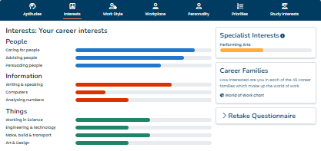
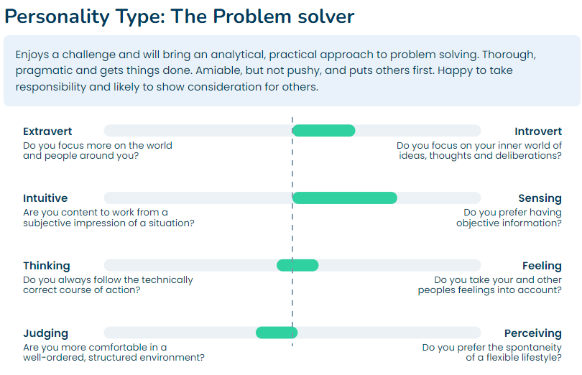
My Profile
Interests & Personality
Notes:
(Slide 9) My Profile – Interests & Personality
Responses to Interests questions are summarised in bar graphs categorised into "People", "Information" and "Things"
Can further explore using “World of Work” link and specialist Interests
Able to use Retake button anytime you feel results are no longer an accurate reflection of your interests.

Slide 10
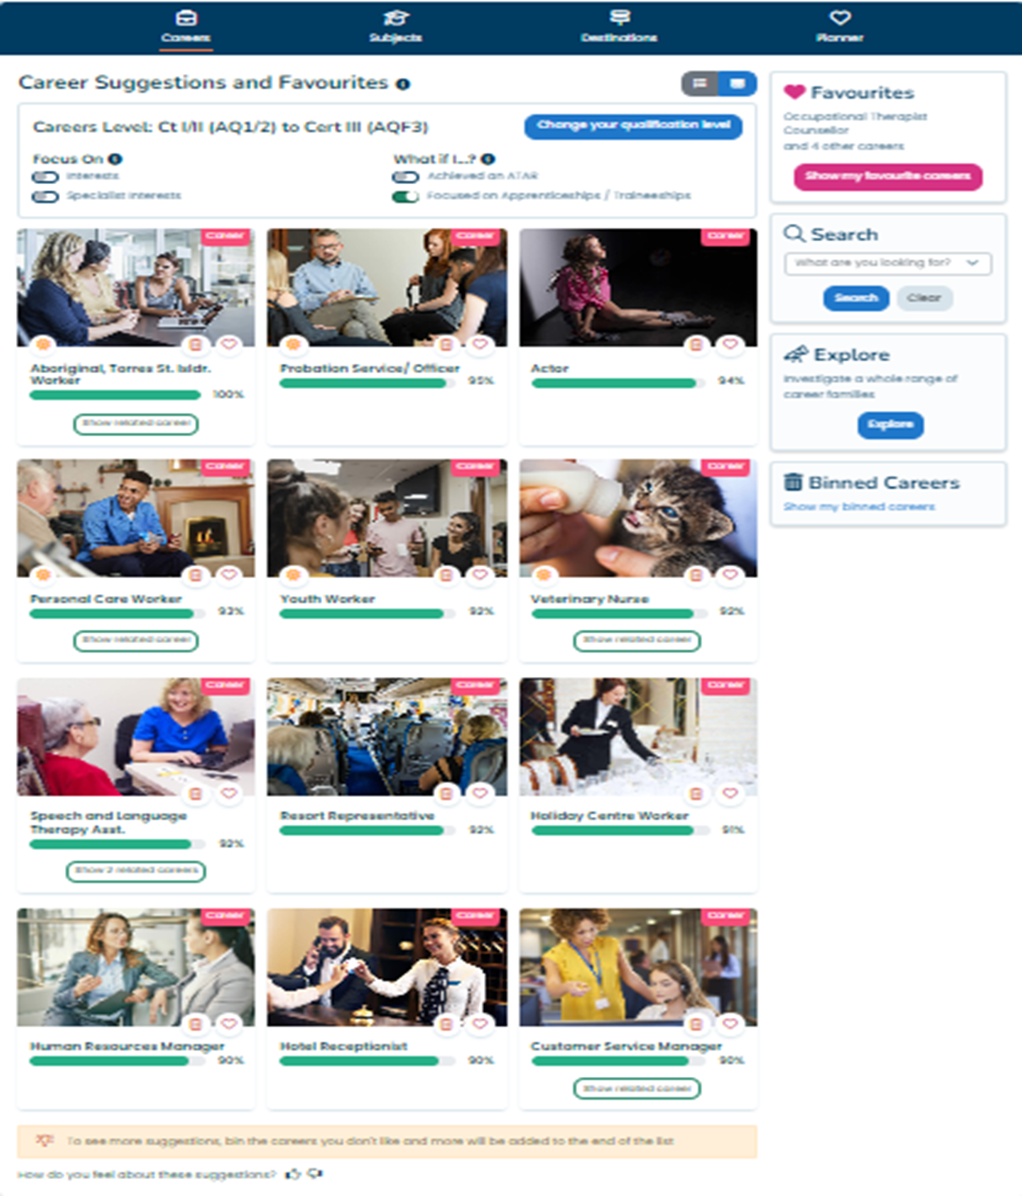
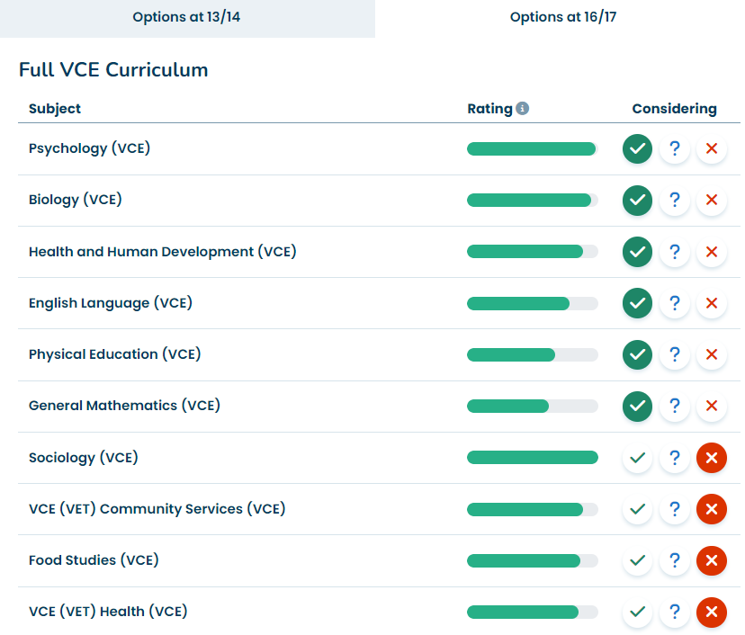
My Profile
Careers & Subjects
Notes:
(Slide 10) My Profile - Career and Subject Suggestions
Based on everything known about you from your profile results, you will see some suggestions and recommendations for future careers and subject selections that suit your personal profile.
Morrisby is also an interactive platform where you can explore and customize careers that appeal to you, study options and pathway preferences.

Slide 11
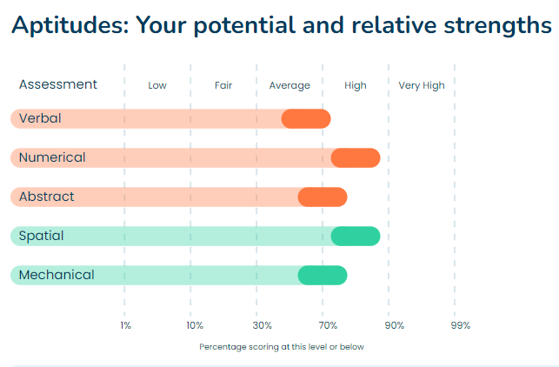
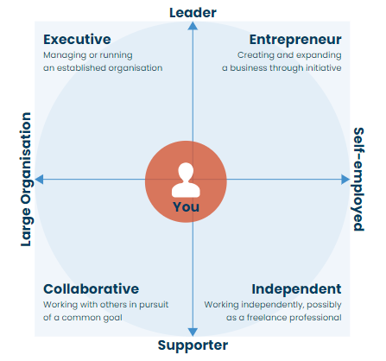
My Profile
Aptitudes & Work preferences
Notes:
(Slide 11) My Profile – Aptitudes & Work preferences
When you return consent and choose to complete the Aptitudes assessments, the full suite of results will be available to you
This will include additional visual and written results - including information about your Aptitude strengths – your ‘brain power’, work and learning style, and practical ability.
It is highly recommended that you do return your consent form and complete the full aptitudes profiling pathway even if at a later date

Slide 12
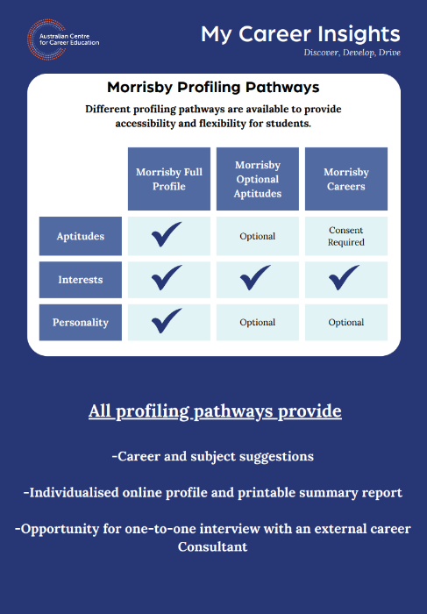
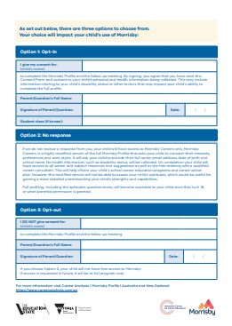
Consent to participate
Notes:
(Slide 12) Consent to Participate
Importance of parent / guardian consent – may determine which profile you can undertake and which report you receive.
Full Profile (requires parent/guardian consent)
The online questions are grouped in 10 sections. The Aptitude quizzes consist of 2 Verbal, 2 Numerical, 2 Abstract, 1 Spatial and 1 Mechanical module (timed) as well as 2 untimed questionnaires - Interests (Aspirations) and Personality.
Optional Aptitudes (requires parent/guardian consent)
This profiling pathway has been designed for students who may not be ready to engage with a full profile at this stage. It begins with the Interests (Aspirations) questionnaire which takes 15- 20 minutes to complete. Students can access full profiling including Personality and Aptitudes at any time.
Careers
This profiling pathway has been designed for st﻿udents who have not been able to gain consent to undertake the full profile. It begins with the Interests (Aspirations) questionnaire which takes 15 - 20 minutes to complete, and allows the option of completing the Personality questionnaire. With consent, students can access full profiling at a later date.

Slide 13
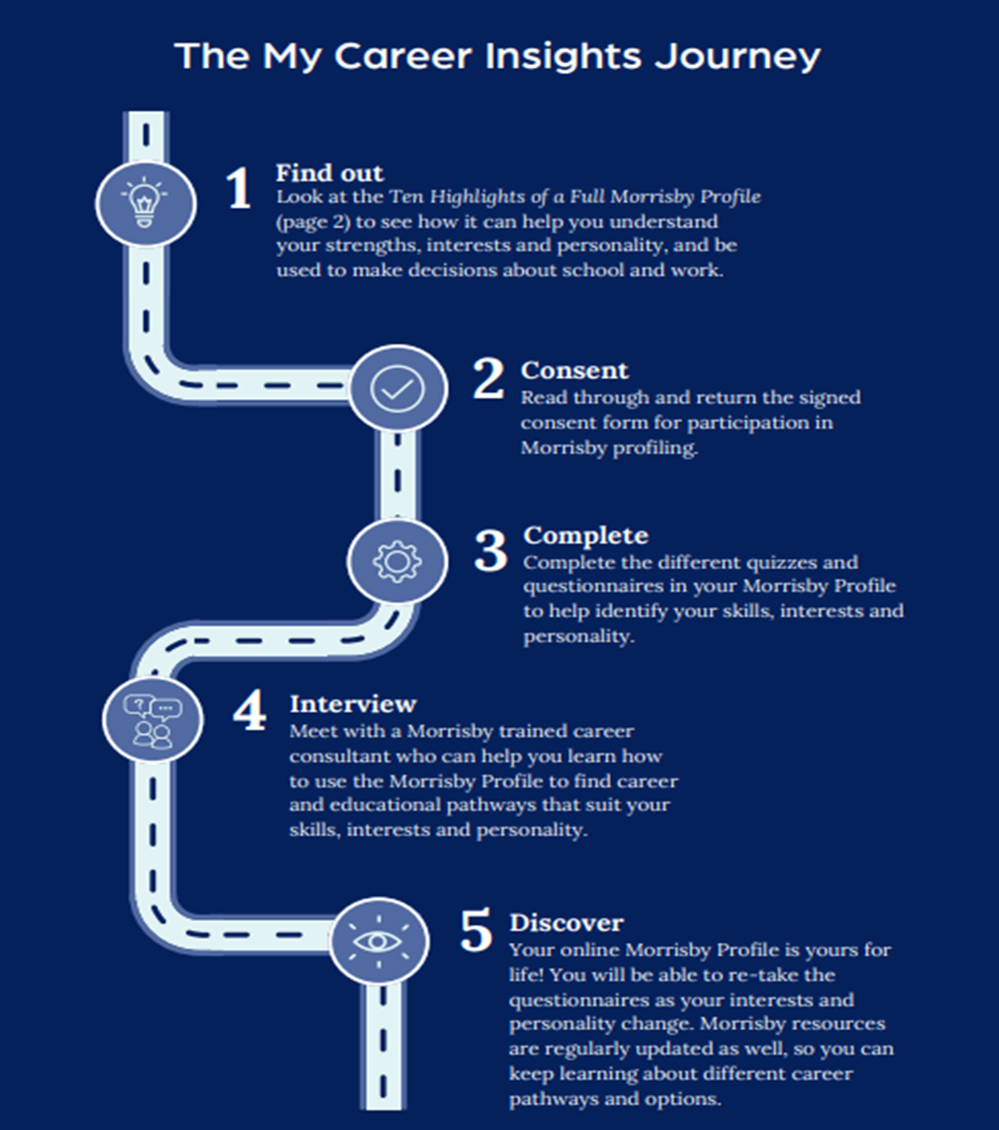
My Career Insights (Morrisby) Journey
Notes:
(Slide 13) The My Career Insights
Summary of Journey
Review the ‘10 highlights’ flyer
Return Consent
Complete profiling
You will be offered a 30-minute discussion with a Morrisby-trained Careers Consultant – to assist you in understanding your results, demonstrate interactive features
Access online profile (life-long) by logging back into the site using your email address and password (make sure you remember/record/check school email)
Explore results, look at career suggestions, print / share digital report with others
Add profile to your school My Career portfolio
Enjoy your self-discovery journey!

