Slide 1
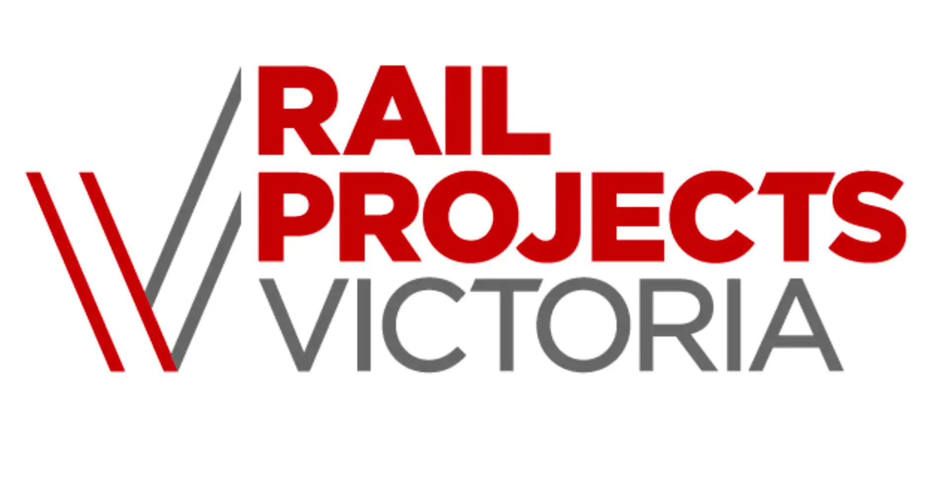
Shepparton Regional Rail Lesson Plan
Industry Training Hubs are funded by the Australian Government
Department of Education, Skills and Employment.
Notes:
The Shepparton Line Upgrade will deliver more frequent and reliable services, and will allow modern VLocity trains to travel to and from Shepparton for the first time.

Slide 2
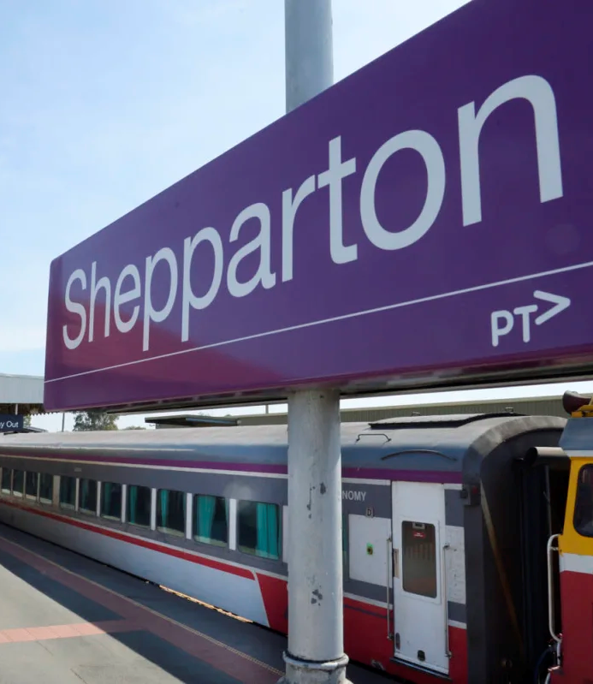
Shepparton Regional Rail
https://www.youtube.com/watch?v=MPH_P1sPRDc
Notes:
Watch this video for a short overview of the project.

Slide 3
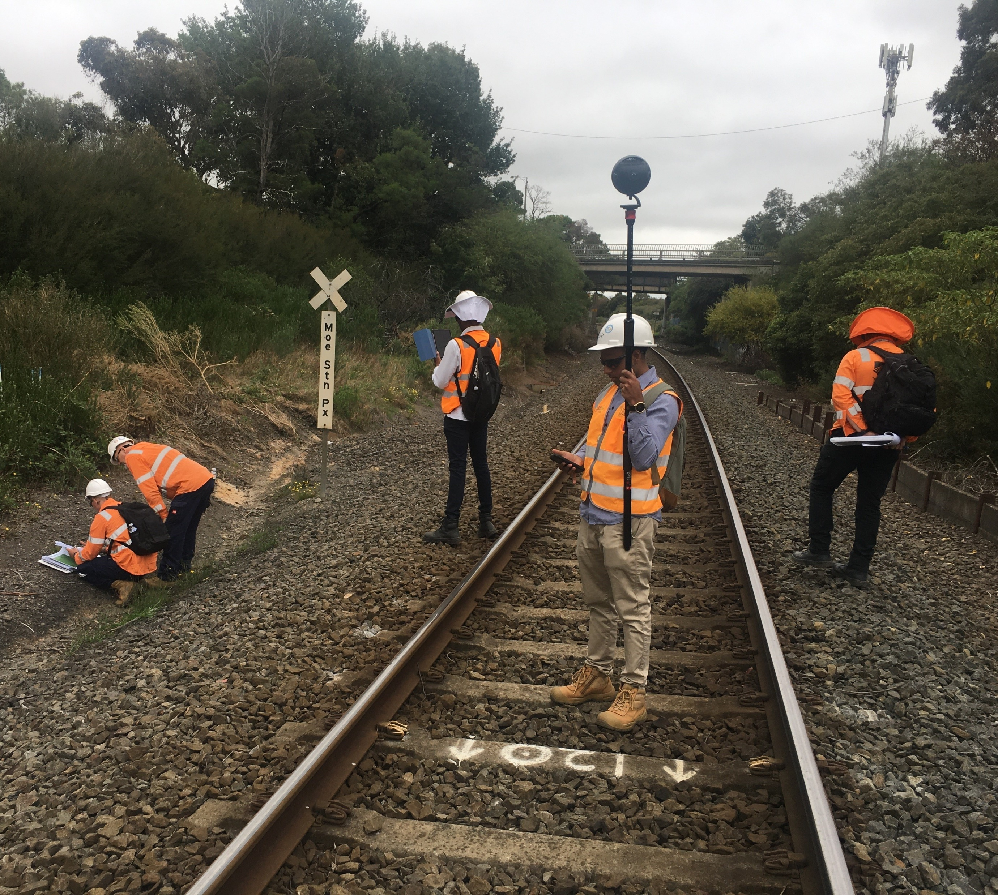
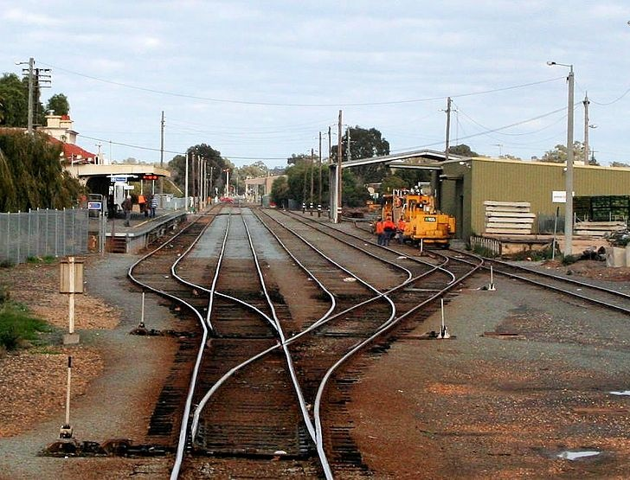
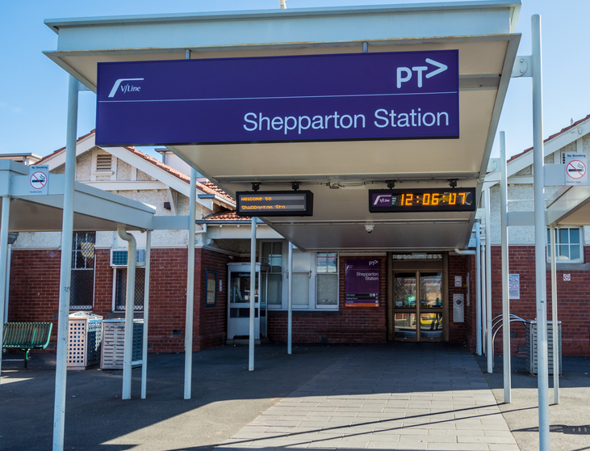
Shepparton Regional Rail
Shepparton Line Upgrade part of Victoria’s Big Build
Stage 3: In Progress
Total cost $436 million
600 jobs created - One of these jobs could be yours!
Notes:
Project overview
The Australian and Victorian governments have funded $400 million for Stage 3 of the Shepparton Line Upgrade, which will allow trains to travel up to 130km/h and enable nine return services to and from Melbourne every weekday.
This investment brings the Victorian Government contribution to the Shepparton Line Upgrade to an unprecedented $436 million, and the total investment in the line to more than $750 million, creating 600 jobs across the project.
Stage 3 of the project will be accelerated by expanding on the upgrades already underway as part of Stage 2 of the Shepparton Line Upgrade.
The new stabling facility being built north of Shepparton to house modern and reliable VLocity trains will be expanded, to accommodate even more trains and enable more services.
Stage 3 of the Shepparton Line Upgrade, which will soon be underway, includes:
signalling upgrades between Seymour and Shepparton to enable nine weekday return services
expanded stabling for VLocity trains to support more services
track upgrades between Seymour and Shepparton to enable trains to travel faster
further extension of the Murchison East crossing loop to boost capacity on the line.

Slide 4
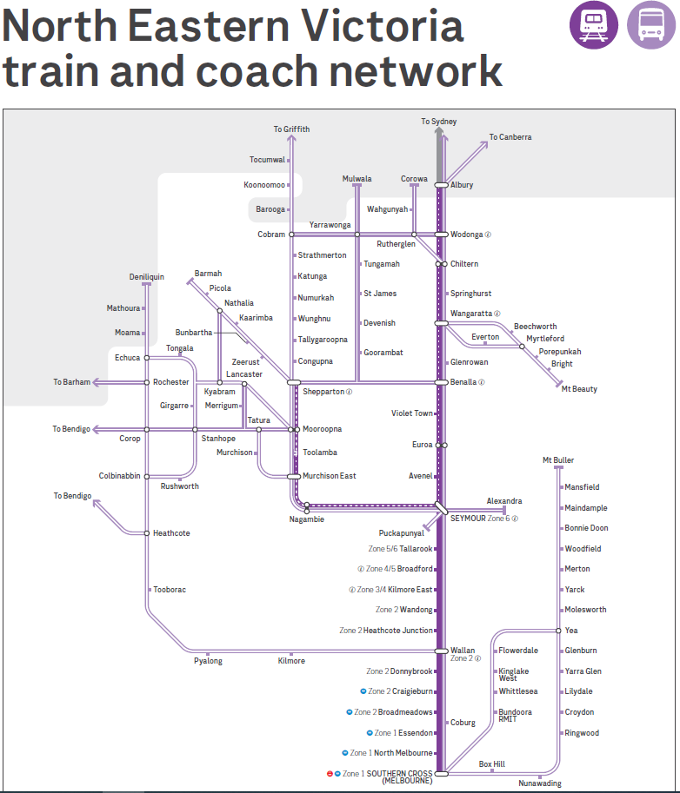
Explore Shepparton Rail
How are we connected?
Notes:
Find the station closet to your home on the map. Is it serviced by train or coach?
How many train and coach interchanges are there in North Eastern Victoria?

Slide 5
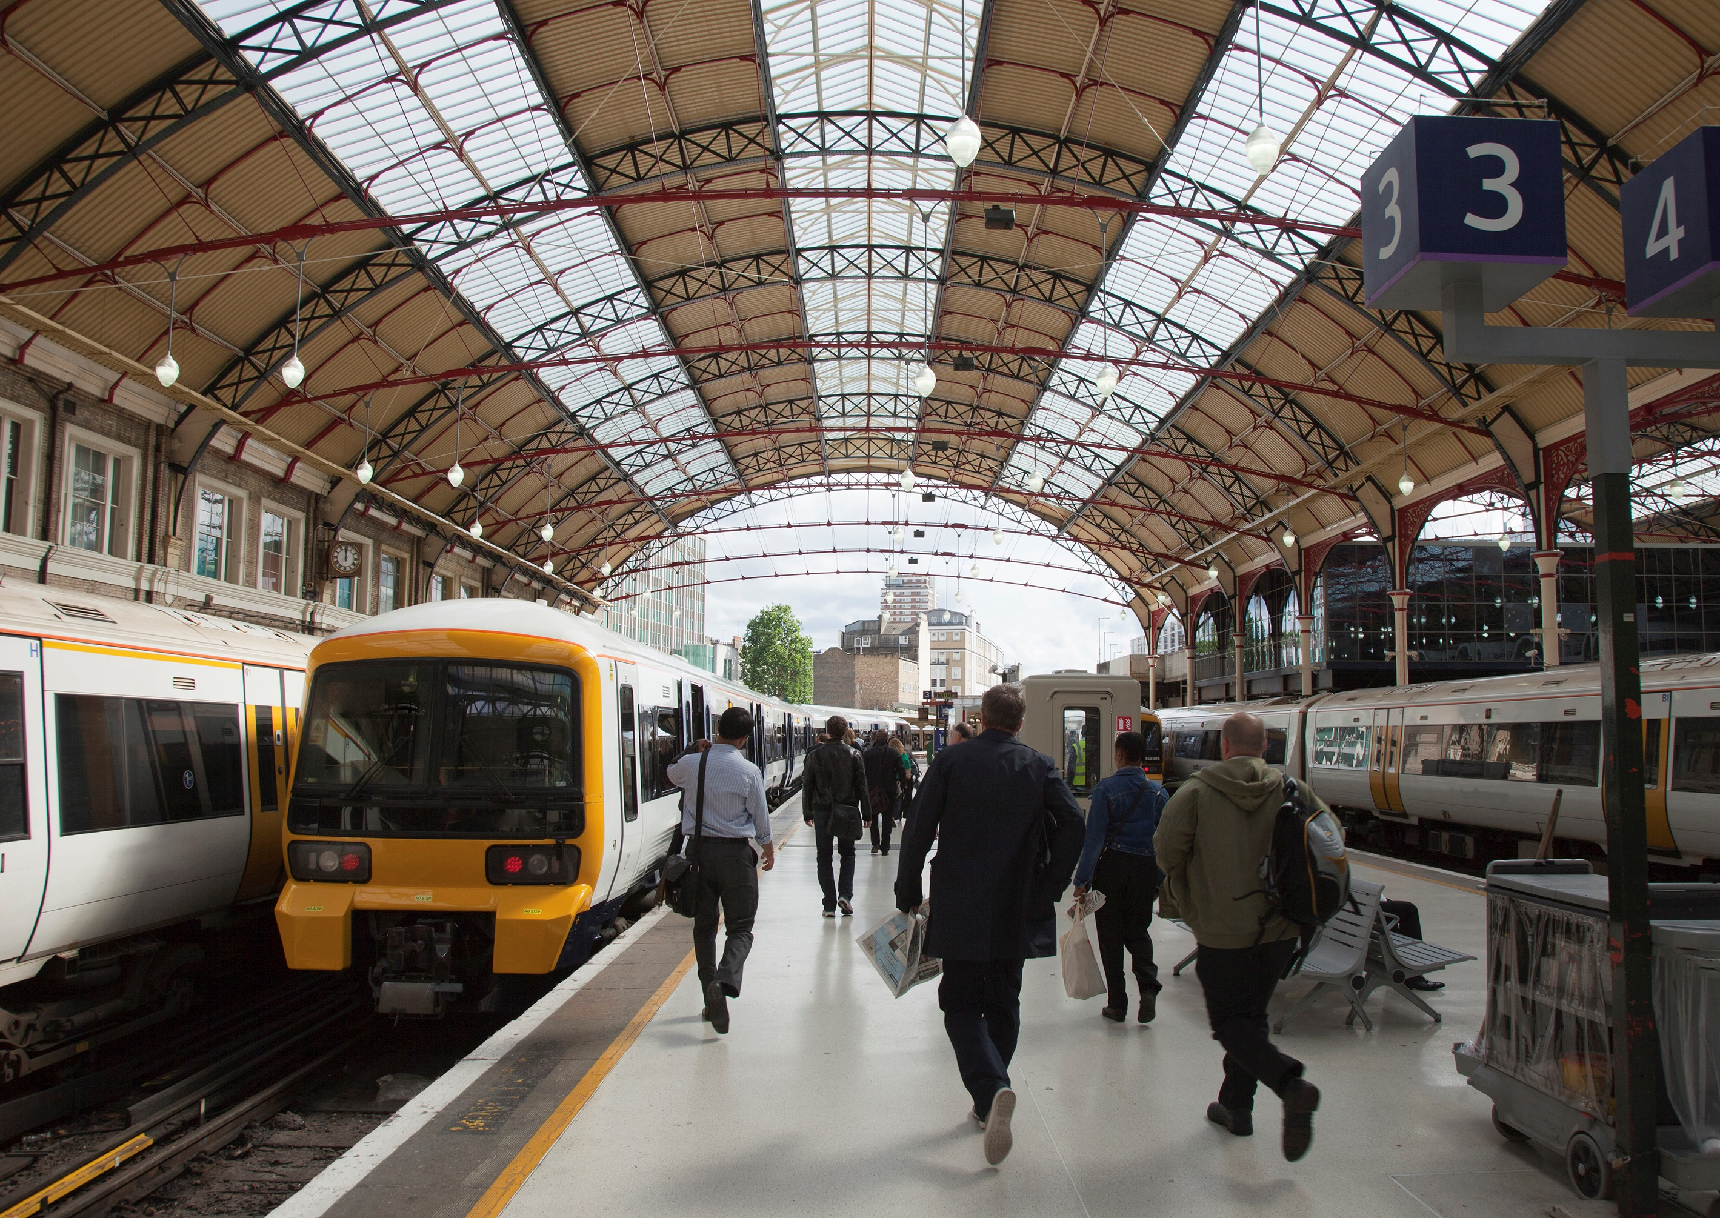
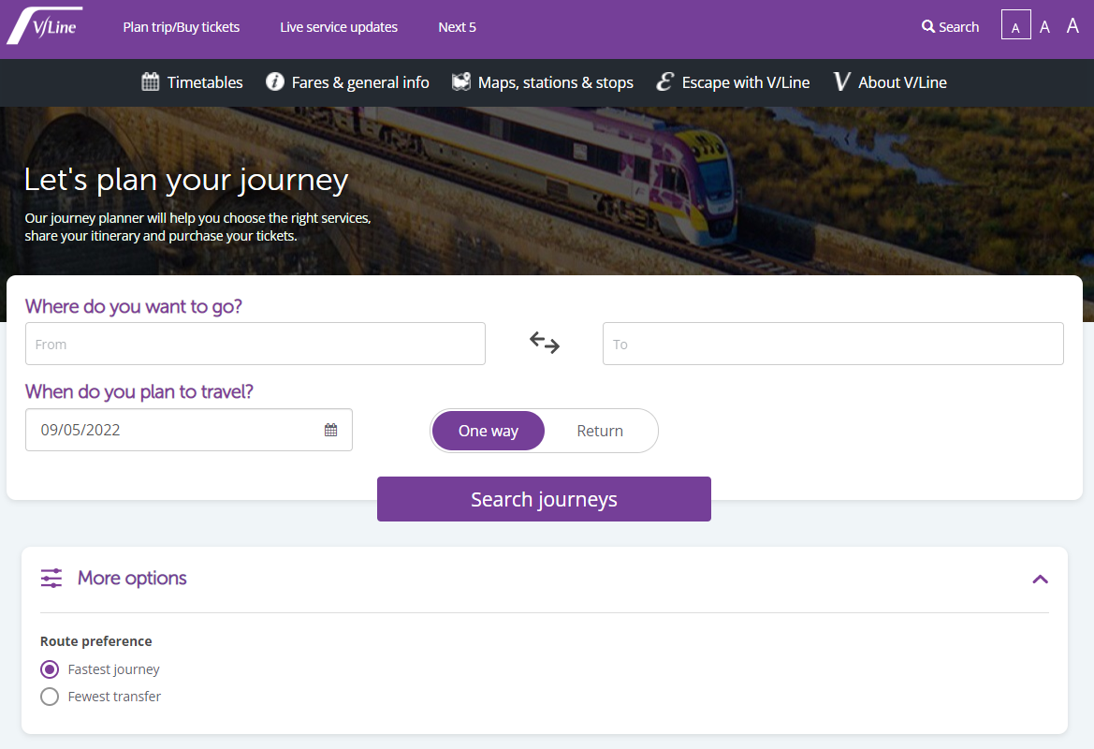
Finding your way around
Tasks:
Using the North Eastern map, how would you travel from Toolamba to Kinglake West?
Using the Vline website, discover how you would travel from Nagambie to Colac. https://www.vline.com.au/Plan-trip-buy-tickets
Consider:
Needing to change trains, at what station?
Changing from train to coach.
Notes:
Complete Tasks 1 and 2
Answers
1. Train to Southern Cross Station – change for coach to Kinglake West
2. Nagambie – Sothern Cross – Colac Station: total 5-6Hrs

Slide 6
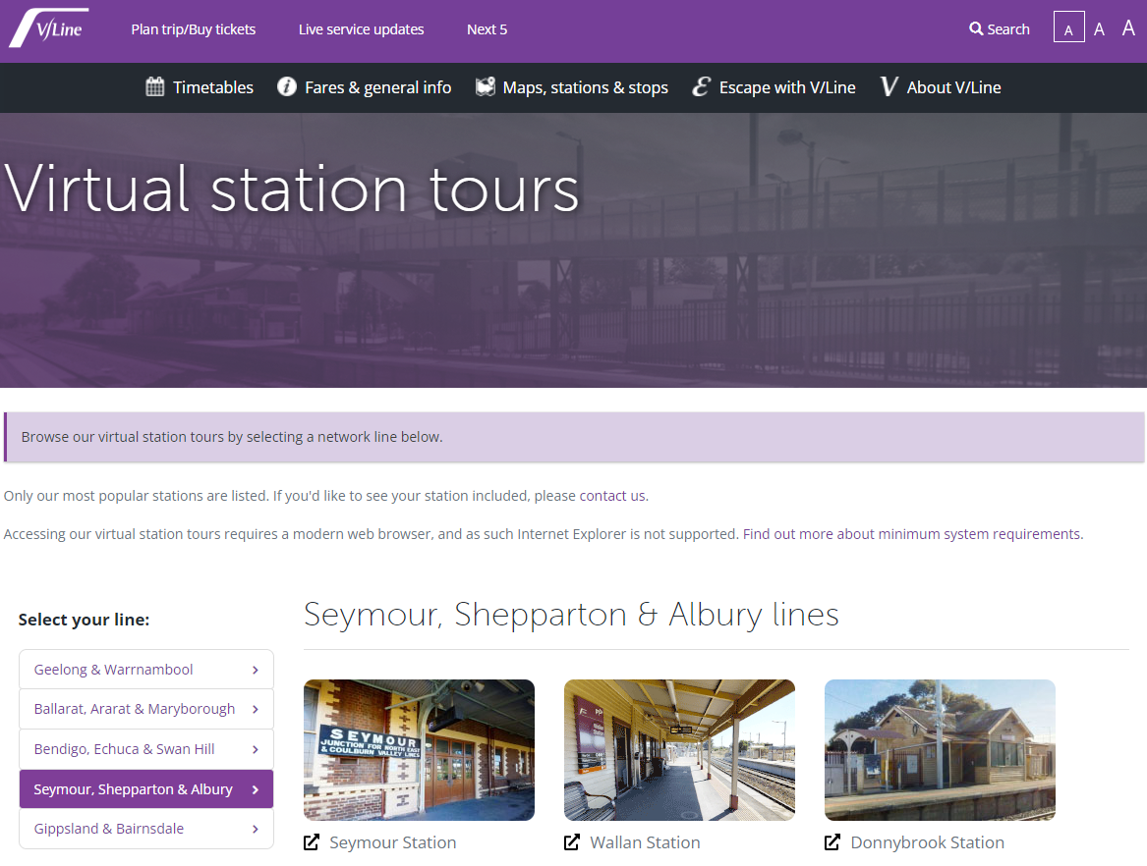
Virtual Station Tour
Using the Virtual Station Tours, explore Seymour Station
https://www.vline.com.au/virtual-station-tours
Questions:
How many platforms are there?
Seymour is the junction for which two lines?
Notes:
Complete Question 1 and 2
Answers:
Seymour station has 3 Platforms
It is the junction of the North-East and Goulburn Valley lines

Slide 7
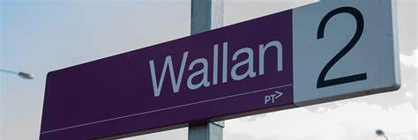
Virtual Station Tour
Using the Virtual Station Tours, explore Wallan Station
https://www.vline.com.au/virtual-station-tours
Questions:
Using the measurement tool:
How far is the Train Replacement Coach stop from the platform?
How far is the carpark from the station entrance?
Notes:
Complete Question 1 and 2
Answers:
Approximately 10 meters
Approximately 13 meters

Slide 8
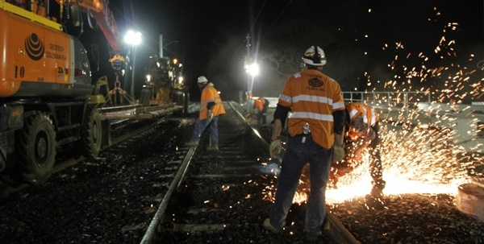
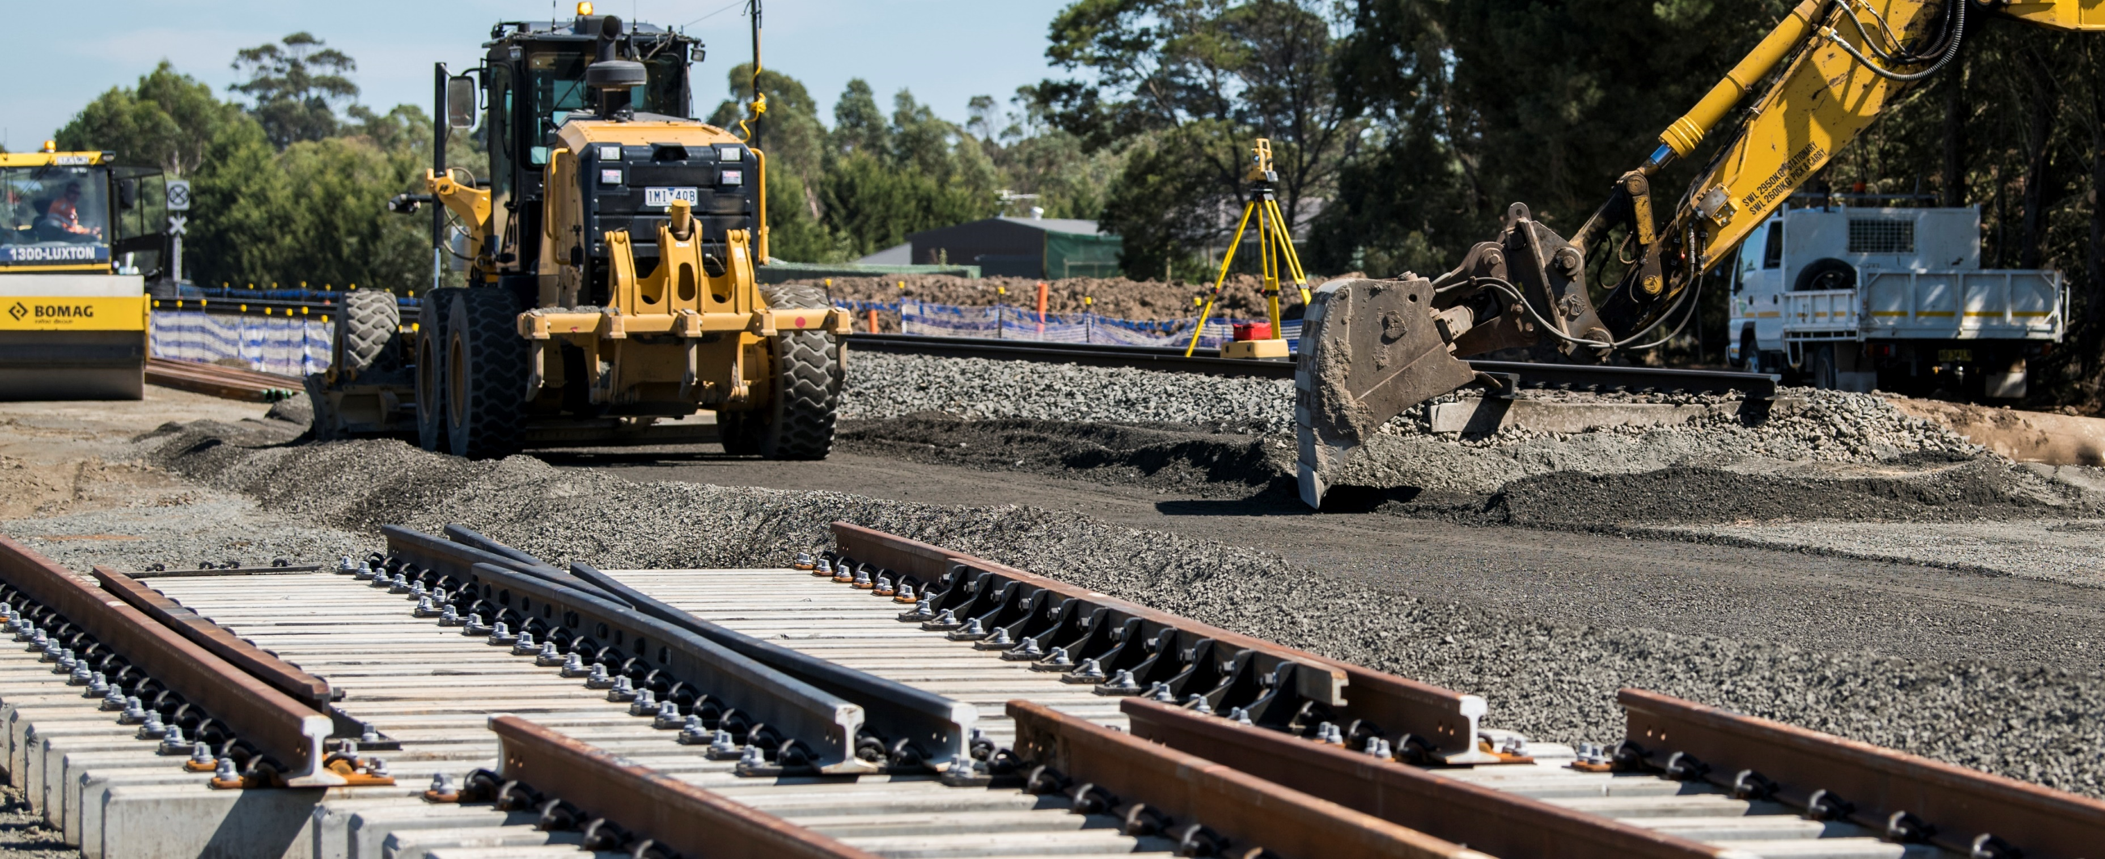
Shepparton Line Upgrade
The Shepparton Line Upgrade is a staged program of works, which will give passengers more reliable services, faster journeys and more modern trains.
Stage 1 of the project is complete and included a stabling upgrade at Shepparton Station, which enabled 10 extra weekly services on the Shepparton line, fast-tracked by nearly 12 months.
Video: https://www.youtube.com/watch?v=LTAorQHmn2I&t=23s
Notes:
Read text and watch video detailing Stage 1

Slide 9
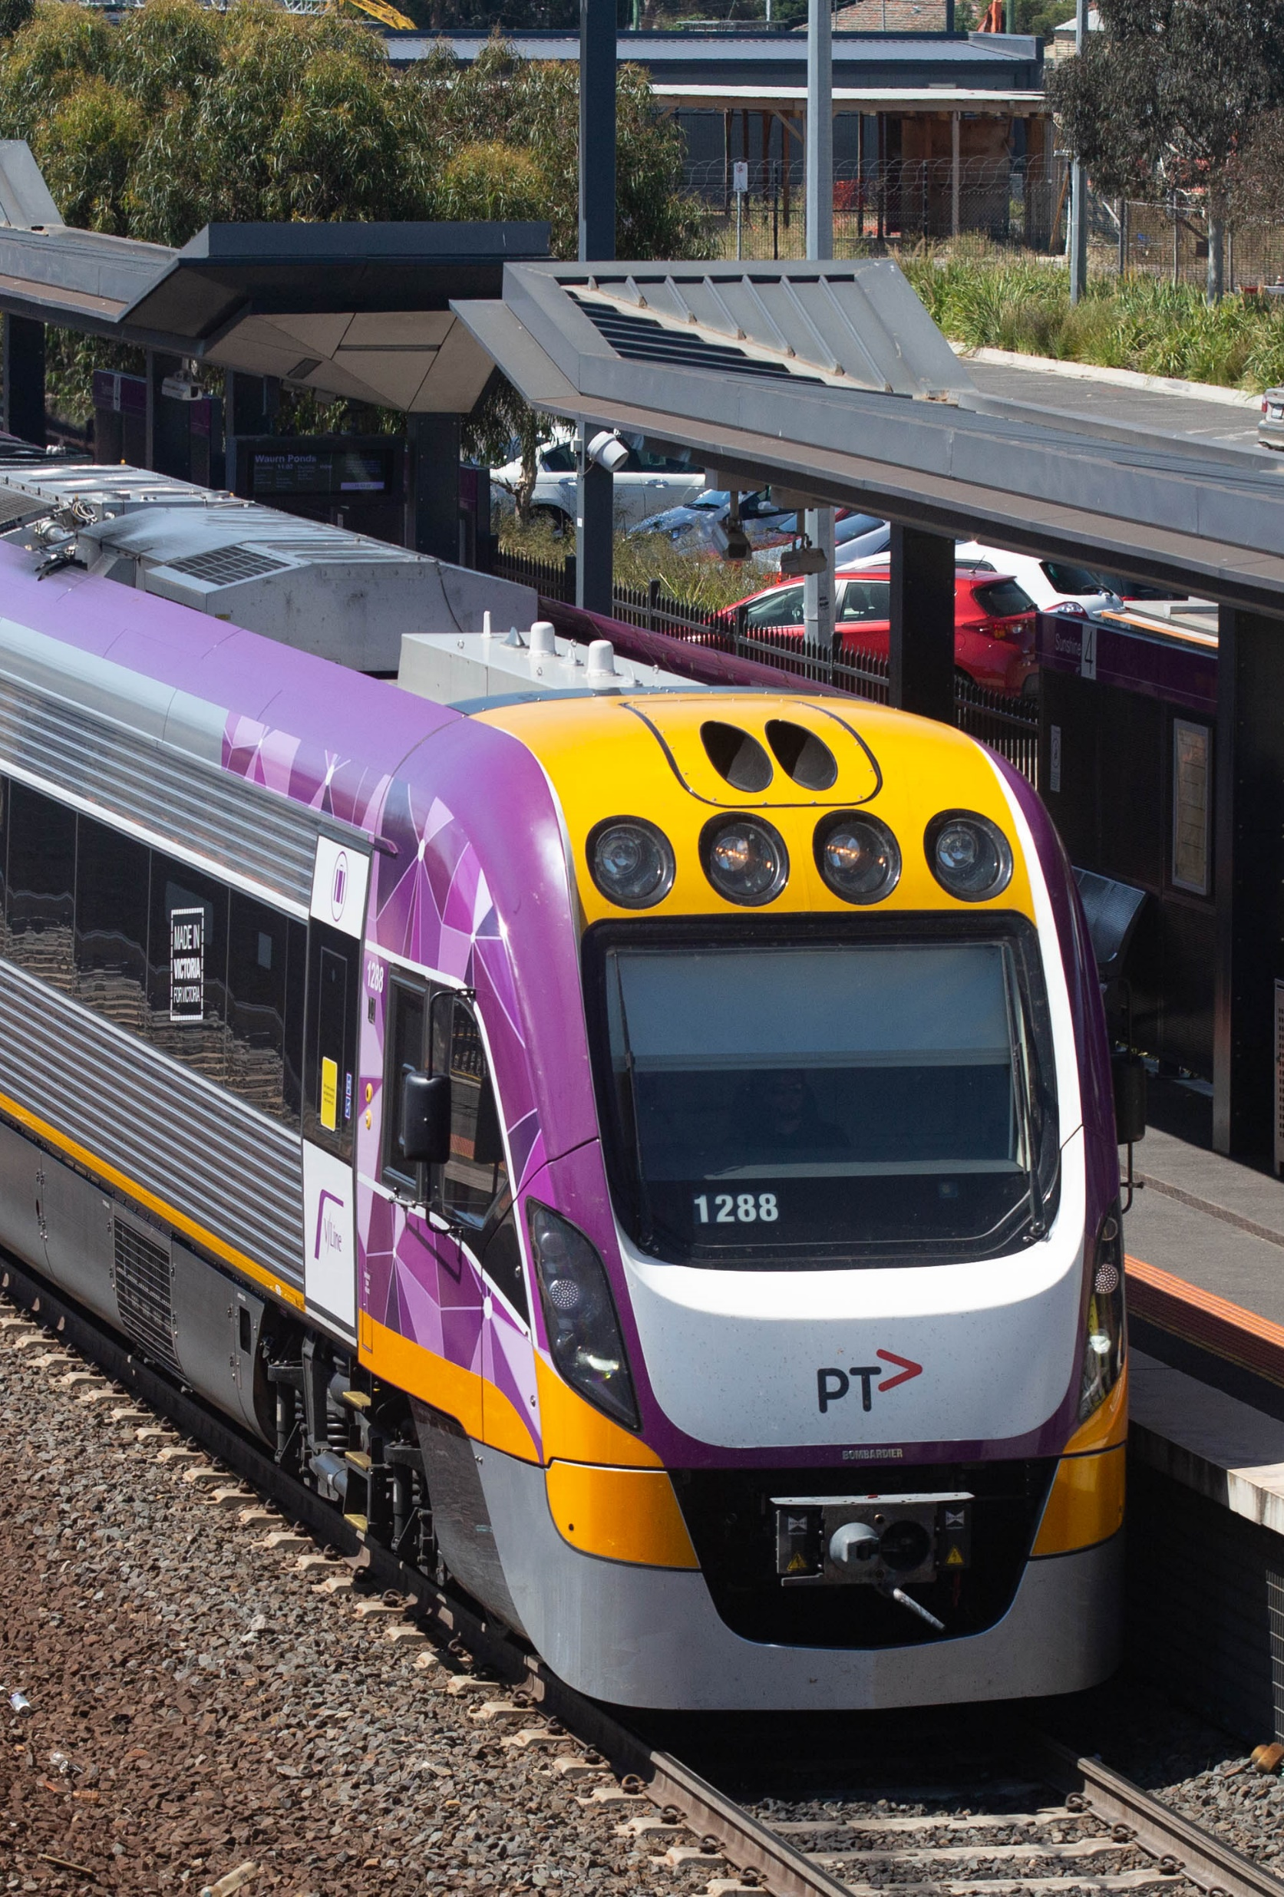
Shepparton Line Upgrade
Stage 2 of the Shepparton Line Upgrade will provide the infrastructure required for VLocity trains to run to Shepparton for the first time, improving service reliability and providing passengers with more comfortable journeys.
This includes a crossing loop extension, platform extensions, new stabling facility to house the trains as well as level crossing upgrades between Donnybrook and Shepparton to ensure they're compatible with VLocity trains and to boost safety for road users and train passengers.
TASK:
Explore the Stage 2 Current Works on the Regional Rail Revival website. https://bigbuild.vic.gov.au/projects/shepparton-line-upgrade/construction/stage-2
Detail and discuss a job you would be interested in applying for work experience or a traineeship.
Notes:
Read text and watch video detailing Stage 2

Slide 10
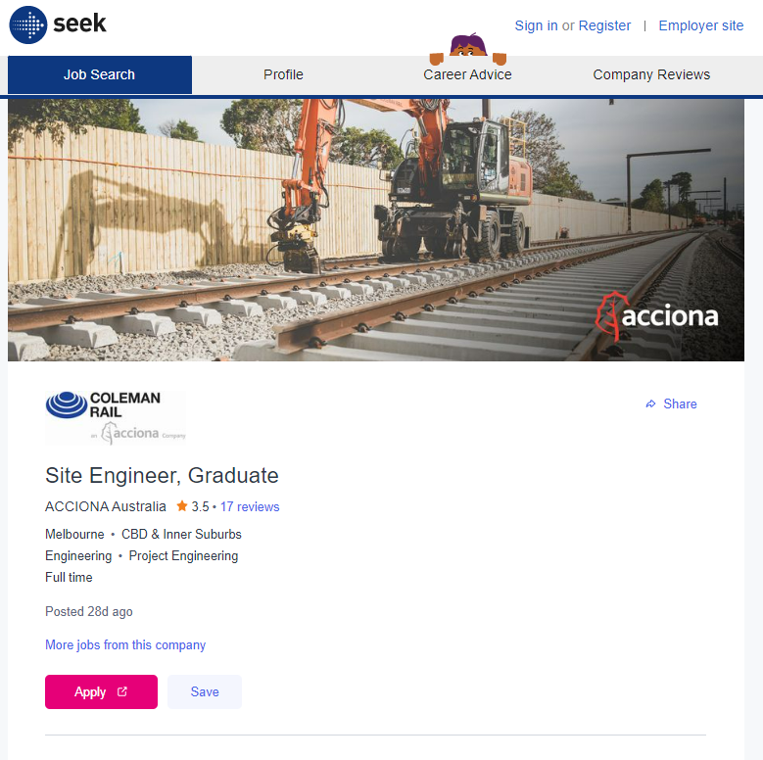
Find a Job with Coleman Rail
Using www.seek.com.au, search for current vacancies
with Coleman Rail.
Questions:
List 2 roles that might interest you in the future.
Where is each role located?
What are the responsibilities of each role?
What are the required skills and competencies?
What interests you about these jobs?
Notes:
Assist students to navigate seek.com.au
Answers will vary depending on jobs currently advertised

